Slide 1
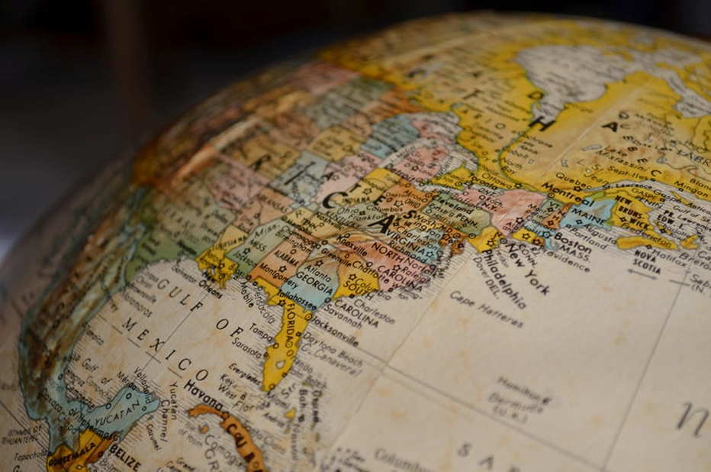
CONTEXT SESSION
What is globalization?

Slide 2
Synopsis
This context-setting session aims to introduce students to the way that globalization has been defined over the past twenty or so years. How can processes of globalisation be defined and grasped? The context session will provide a brief introduction to the history of modern globalization and how it links with capitalism.

Slide 3
GlobaliZation
made possible by the global media and particularly the new communication technologies
Globalization:
  A blanket term to describe the transnational processes and flows of people, goods, and capital
  Sovereign national states have become undermined by transnational actors
  …the intensification of world-wide social relationships which link distant places in such a way that local happenings are shaped by events occurring many miles away and vice-versa. (Giddens 1990:64)
Types:
  Political globalization
  Economic globalization
  Social and cultural globalization
Notes:
Globalisation is one of the most frequently used buzzwords of today as it concerns cultural, political and economic aspects of life. Contemporary globalisation is made possible by the global media and particularly the new communication technologies with their ‘global reach’. Globalisation is impacting on the lives of everyone, everywhere; it is changing consciousness too, as everyone becomes more globally aware and oriented. Globalisation may thus be the defining feature of human society in the twenty-first century.
What is globalisation? Defining and theorising globalisation is problematic. Gobalization has often been used as a blanket term to refer to transnational processes and flows of people, goods, capital, and so forth, through which sovereign national states have become undermined by transnational actors (such as transnational corporations, political organization, and the like).
Anthony Giddens proposed that globalisation is “…the intensification of world-wide social relationships which link distant places in such a way that local happenings are shaped by events occurring many miles away and vice-versa” (Giddens 1990:64).
Globalisation thus refers to:
an intensified compression of the world;
our increasing consciousness of the world.
It is important to distinguish forces of globalisation as these operate in different contexts:
political globalisation (as evident in the former ‘second world’ countries, which have moved away from socialism to liberal democracy and markets of Western variety; or evident in certain ‘Pacific Rim’ countries);
economic globalisation (evident in the global economy through global trading and capital markets);
social and cultural globalisation.

Slide 4
Globalization
Globalisation can result in:
  cultural homogenisation/ homogeneity as an outcome of the impact of Western media and consumerism; or
  the emergence of new, exciting global cultural networks and hybrids; termed ‘cultural hybridisation’
First view: cultural imperialism thesis
More recently, latter view , also termed ‘creolization’
Popular music = one of the globalisers
Notes:
Within the context of music, we will focus predominantly on ‘cultural globalisation’. This term refers to the movement of culture, as everyone everywhere is affected by intensive and extensive forms of cultural flows.
The processes of cultural globalisation can result in:
cultural homogenisation/ homogeneity as an outcome of the impact of Western media and consumerism; or
the emergence of new, exciting global cultural networks and hybrids; termed ‘cultural hybridisation’.
Accordingly, cultural globalisation can be viewed in two different ways: as (a) threatening, impoverishing and destructive of local culture and business; or (b) as progressive and liberating. The first view is closely related to the cultural imperialism thesis (or, media imperialism, that is, the cultural domination by economically powerful Western culture industries through their ownership of the means of production and transmission of cultural goods within the global capitalist market), which, it is believed, is eroding local (indigenous) cultures and traditions, and replaces them by the icons of Western (especially American) popular culture.
However, cultures have been, are and will always be in flux; no culture has ever existed in a ‘pure’, pristine state. Instead, cultures are dynamic, rather than static; they change constantly in response to inside and outside pressures. So whilst cultural homogenisation (‘from the West to the rest’) has occurred to some degree, local and national alternatives are constantly reviving.
Also, globalisation is uneven in its impact across the world on the basis that people are NOT passive receptacles of cultural products because reflexivity (people’s perceptions) intervenes. People’s reaction to cultural products (music, fashion, television) thus varies across the world; there is no one uniform response. In other words, the global is received in different ways in different locals, and there is unlikely ever to be a homogenous global audience.
The increasingly global cultural diversity is termed cultural hybridisation, or sometimes ‘creolisation’, which is defined as a process of re-contextualization and meaning re-attribution. In other words, foreign cultural imports are assigned new meanings within the receiving culture, leading to the emergence of new local, hybrid forms and identities.
One of the principal agents of cultural globalisation is ‘pop music’, also regarded as one of the great ‘globalisers’. It is now literally ‘everywhere’. While the market is dominated by American and British pop music, it is the archetypical product of Western capitalism.

Slide 5
perspectives on globalization
a form of globalization has been in progress throughout history
globalization is an outcome of capitalism in the modern period
globalization is the product of the post-Fordist disorganised capital of post-industrialism and post-modernity that has replaced old Fordist organized capital.
Notes:
Let us begin by looking at various historical perspectives on globalisation. How and when did globalisation start to develop? There are three standpoints concerning the origins of globalization:
1. a form of globalization has been in progress throughout history;
2. globalization is an outcome of capitalism in the modern period;
3. globalization is the product of the post-Fordist ‘disorganized capital’ of post-industrialism and post-modernity that has replaced old Fordist ‘organized capital’.

Slide 6
Historical perspectives
Europe at the centre of a ‘global ecumene’
‘European superiority’
Notes:
A form of globalization has been in progress throughout history. According to Roland Robertson (1992), globalisation may be mapped onto five historical phases:
phase, 1400-1750: marked by global exploration and spread of Catholicism, adoption of the Gregorian calendar, mapping modern geography, growth of national communities and the state system;
phase, 1750-1875: marked by the emergence of internationalism, and the European-dominated ‘international’ society;
phase, 1875-1925: described as the ‘take-off-phase’ of globalisation, marked by globalising tendencies (i.e. communicational advances; increasing economic and political connections; Olympic movement; the first ‘world’ conflict);
phase, 1925-69: described as the ‘struggle-for-dominance’ phase (world war II); founding of the UN and other ‘global’ organisations;
phase, 1969-date: the end of the Cold War; the moon landing and planetary exploration; emergence of global institutions and global mass media; world-wide debates around race, ethnicity, sex, gender sexuality and human rights.
Roberton further believes we may already have entered a 6. phase, one of global uncertainty (due to health, environmental, cultural and other ‘global’ risks). In this phase, the long-term outcomes of globalisation are uncertain.
Held et al (1999) by comparison see contemporary globalisation as a successor of four historical periods, which are marked by spatial, temporal and organisational circumstances as follows:
The pre-modern (before 1500): here, globalisation was ‘interregional’, based on empires in Eurasia and the Americas and the movement of peoples into uncultivated areas;
the early modern (1500-1850): marked by the rise of the West and the movement of Europeans to America and Oceania; spread of world religions (particularly Christianity and Judaism);
modern globalisation (1850-1945): marked by an acceleration of global networks and cultural flows, and dominated by the European power (esp. the British); mass migration of Europeans to the New World, which transformed the Americas technologically, culturally and otherwise;
contemporary globalisation: marked by degrading environment and new patterns of global migration; a world-wide system of nation-states, overlaid by regional and global forms of regulation and governance; less dominated by America and Europe; truly global impact of communication and transport; everyone everywhere is ‘connected’.

Slide 7
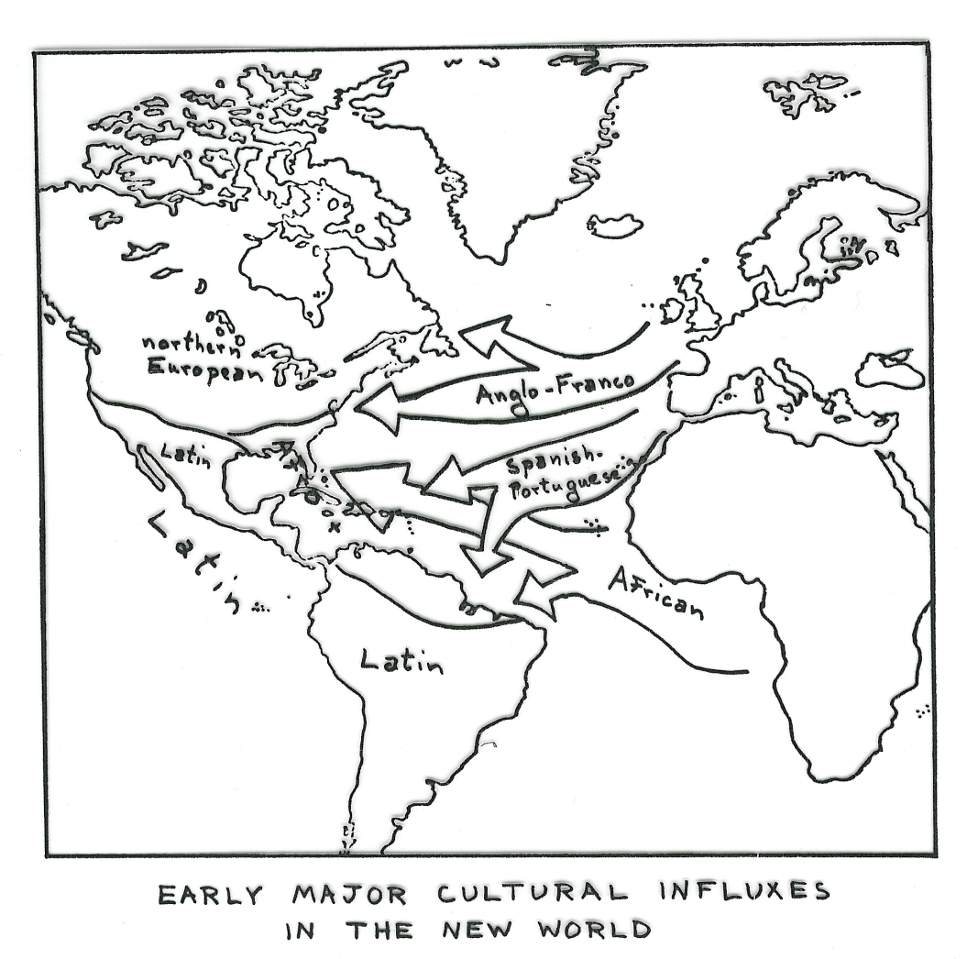
Notes:
Historically, one of the most significant steps was the outward expansion of European institutions and culture from the late 15th century. The explorations by leading maritime nations (i.e. the Spanish, British, French, Portuguese) had a number of consequences:
the expansion of geographical knowledge with a placing of Europe at the centre of the then known world;
the expansion of technical information as the European nations improved their techniques of marine construction and navigational skills (including sails from India; the compass and gunpowder from China; the astrolabe from Arabia);
the emergence of a ‘global consciousness’ and the capacity to conceive of the world as an accessible and attainable whole that could (and was) explored and exploited;
a mission to spread European culture, institutions and Christianity globally under colonisation, which many colonised countries willingly adopted;
the international acceptance of European standards (Gregorian calendar; Greenwich meridian; the nation-state);
the acceptance in Europe of new produce (spices; herbs; potatoes; tomatoes; green beans; peppers; chocolate) in the 16th century, resulting in dramatic local impact.
[Image source: David Reck (1997). Music of the Whole Earth. Da Capo Press Inc.]

Slide 8
Spotlight on Latin America…
Peoples of African, Asian and European stocks brought together
1492, the Italian, Christopher Columbus reached the island of San Salvador, calling it ‘India’ and the inhabitants ‘Indian’; later he discovered parts of the Carribean…Spanish claims
1519, historic encounter of the mountain capital city of the Aztecs (Tenochtitlan) with imperial status, ruling some twenty million people in Mesoamerica (with strong cultural traditions adapted from the Maya’s civilisation)…present-day Mexico City
Promulgation of the Roman Catholic faith throughout Latin America; Native Americans acquiring expertise in European polyphonic music
1524, Spanish conquest of the Incas of Peru, ruling present-day Ecuador, Peru, Bolivia, and parts of Argentina and Chile (also superb artistic traditions and culture)
Spanish hold on Meso- and South America with Mexico and Peru (the most populated areas) as chief centres of colonisation
Notes:
By the end of the 18th century, a ‘global ecumene’ had emerged with European institutions being transplanted across the world. This was followed by mass migration of European peoples to the New World and later Australia and New Zealand in late 19th and early 20th century. Under the impact of railroads, industrialisation, the imitation of European high culture and taste, and explorations of ‘other, exotic’ cultures, the influence of the West intensified. World history was equated with European history and the advances of technology and science, literary and artistic achievements, and the belief in rationality and creativity, leading to a concern with ‘European superiority’ over the rest of the world.

Slide 9
2. Globalisation as an outcome of capitalism in the modern period
a ‘consequence of modernity’ (Giddens 1990)
‘high modernity’… modernity has now moved into a global stage
‘world society’
Notes:
2. Globalisation is an outcome of capitalism in the modern period
According to Anthony Giddens (1990), globalisation is a ‘consequence of modernity’, thus the development of modern societies, industrialisation and accumulation of material resources. He terms this ‘high modernity’, by which is meant that modernity has now moved into a global stage (society has become a ‘world society’ and the individual is confronted by (now global) social institutions. Three factors in the 19th century have resulted in contemporary globalisation: (a) European nations’ conquering and colonising of tribal societies; (b) British investments in colonial ambitions; and (c) European diplomatic networks and transnational political and business agencies. Giddens argues that the nation-state remains at the heart of contemporary globalisation, and that capitalism has fuelled the globalising tendency.

Slide 10
3. Globalization is global capitalism
postmodernity
the ‘logic of late capitalism’ (Jameson 1984; 1991)
Notes:
3. Globalization is the product of the post-Fordist ‘disorganized capital’ of post-industrialism and post-modernity:
The capitalist position defines globalization as follows:
more inter-state connections and the decreasing effect of state policy;
the development of increased transnational communication and activities;
a decline in the importance of the nation-state;
the emergence of global political, economic and cultural organisations and bureaucracies;
the emergence of ‘global cities’ (like London, New York, Paris, Tokyo) as local sites of global interaction;
a huge increase in the flows of commodities and cultural products;
the world-wide spread of Western-style consumerism.
Postmodernity is the latest stage of capitalism, termed as the ‘logic of late capitalism’ or (later) neoliberal capitalism. In this view, market capitalism (appr. 1700-1850) gave way to modernism’s monopoly capitalism (1850-1945), which has now in turn led to a late capitalism, characterised by multi- or transnational corporations’ domination of an increasingly global marketplace.
In other words, postmodernity is capitalism in its post-Fordist guise, empowered by new technology. This is marked by a move from mass to flexible production based on lifestyle and niche marketing. [Since the 1960s, in order to create new markets, capitalism has ‘renewed’ outdated working practices and replaced traditional ‘high culture’ with a new aesthetic (based on the image industry, i.e. in fashion, pop music and lifestyle) through advertising and the media (part. TV), on a global basis, and led by (predominantly) Anglo-American-owned corporations.]
Postmodernity is the result of fundamental changes in social, economic and political processes, notably the shift from a Fordist to a post-Fordist economy that is based on information technology, robotics, diversity, decentralisation, differentiation and globalization. Culturally, postmodernity marks the emergence of a more liberated era, different from the modernist era, thus meaning the final end of the Enlightenment project.

Slide 11
Excursion: What is Fordism and post-Fordism?
 | Fordim | Post-Fordism
Products
Division of labour
Marketing
Quality control
Stock control
Use of technology
Wages
Horizontal design
Vertical design
Notes:
[Set students the task to conduct a “quick” google search or read relevant literature to identify the differences between Fordism and post-Fordism.]

Slide 12
 | Fordim | Post-Fordism
Products | standardized | Flexible, variable
Division of labour | Separation of tasks | Multiskilling, horizontal
Marketing | Promotion & advertising | branding
Quality control | Top-down, post-production | Bottom-up, by labor force during manufacturing
Stock control | Large buffer stock | JIT stock management
Use of technology | Not necessary | New technology essential
Wages | Relatively high for core workers, incentives for motivation; low for peripheral workforce (women, people of colour) | High for core workers; large peripheral workforce (short and part-time, low pay, often minorities)
Horizontal design | n/a | Horizontal synergy, Sub-contracting horizontally with independent companies
Vertical design | Top-down management
Notes:
Generally, responses to postmodernism are divided: (a) one camp regard the changes as a liberating response to modernism and the promise of a democratic, ‘free’, pluralistic, post-industrial, post-class society of multiple lifestyles; (b) another more pessimistic view regards postmodernism as little more than niche marketing and flexible specialisation, increased commodification and packaging, yet still adhering to the old, exploitative ways of capitalism.

Slide 13
Globalization
  Increasing speed and volume
  Shrinking space
  Permeable borders
  Reflexivity
  Risk and trust
Notes:
More generally, a number of features mark out contemporary globalization:
Increasing speed and volume. Speed of movement (via travel or technologies) and the volume of goods, messages and symbols in circulation have now greatly accelerated and work simultaneously on a number of levels (i.e. economic, political, cultural and individual).
Shrinking space. Space appears to shrink as travel and communicational time decreases. Instantaneous/ synchronous (tele)communication led to ‘global shrinkage’, with consequences for the phenomenological elimination of space, and the ‘distanciation’ (divorce) of time from space. With the development of ‘distanciated networks’, social relations become ‘disembedded’ (that is, stretched over vast distances).
Permeable borders. The interconnectedness between all nation states and the wider world is increasing, made possible through trade, tourism and electronically. Total national autonomy or isolation is almost impossible to maintain, described by some as ‘the death of the nation state’. Whilst it may be too premature to talk of a ‘global society’, the fact is that globalisation affects everyone. How? Satellite-beamed images reach everyone. Environmental pollution (global warming) is evident worldwide. Global economy affects everyone.
Reflexivity. People increasingly orient themselves to the world as a whole, regarding themselves both as ‘locals’ and ‘cosmopolitians’. Globalisation affects everyone in material and personal ways. People are increasingly ‘thinking globally’ and are ‘globally aware’, i.e. we reproduce the global in our daily lives. Giddens (1990) termed this ‘reflexive modernity’, which is characterised by an increasing flow of information, images, symbols, and purchasable ‘lifestyle’ identities.
Risk and trust. Globalisation involves everyone in a web of trust and risk, i.e. trust in unknown experts; faith in science and medicine; stock exchange market. Beck (1992) takes this theme further in ecological terms and labels the emerging global society as the ‘risk society’ (i.e. global ecological threats, such as global pollution, global warming, nuclear accidents and acid rain). Such risks are truly global; and are multiplying (termed by Beck the ‘boomerang effect’, as it affects both perpetrators and victims, rich and poor alike).

Slide 14
Globalization
  an intensified compression of the world
  our increasing consciousness of the world
Notes:
Globalisation thus often refers to:
an intensified compression of the world;
our increasing consciousness of the world.
While this definition point towards an accelerated ‘coming together’, widely associated with globalisation, there is simultaneous fragmentation. Indeed, surges in local, regional and nationalistic pride, and the push for nationhood, are very much part of the globalisation process. Rather than being about unity, globalisation is about increasing diversity simultaneously operating at a number of levels.

