Slide 1

Session 1
The “Birth” of Popular Music under Liberal Capitalism

Slide 2
Synopsis
To understand the beginnings of modern globalization, we need to consider the processes surrounding (cultural) modernization under the influence of liberal capitalism from the late nineteenth century. In particular, musical modernization meant to balance advantages of west and east, old and new, including the adoption and integration of western sound recording and broadcasting technology and other products of western culture. New technologies and mass media aided the wide dissemination of popular music and its commodification for profit. The phase of musical modernization has transformed indigenous and national cultural formations under the impact of the spread of western culture on musical practices since the nineteenth century.

Slide 3
introduction
Since the mid-nineteenth century, old forms of market capitalism (ca. 1700–1850) became gradually replaced by modernism’s monopoly capitalism (also known as liberal capitalism) (ca. 1850–1930), which emerged nationally and soon spread, through international trade, internationally.
valorization of European superiority
late nineteenth century until 1930s: transition from tradition to modernity
Modernization meant…
  urbanization, early industrialization, early capitalism, westernization, and spread of institutionalized forms of education
Notes:
Since the mid-nineteenth century, world history was written in such a way to valorize Europe, and its advances in technology and science, literature and art, and to spread concepts of rationality and creativity as superior over the rest of the world.

Slide 4
Introduction
Musical modernization…
  modernizing “traditional” music
  emergence of so-called “popular traditions”
  musical commodification and passive pop consumption
  new sound recording and broadcasting technologies
Musical modernization…
  production of cultural commodities
  changing nature of music as a commodity
  rise of the ideology of exchangeability
  rise of the individual artist and concept of genius
  rise of social class and, with it, differences in cultural production and consumption
Notes:
The most dominant response to westernization occurred in the realm of musical modernization, brought on largely by economic reasons, but also for reasons associated with personal, social, and cultural values. Musical modernization meant the spread of western influence to many parts of the world, and it succeeded due to western music’s perceived complexity, specifically classical and art music, its accompanying technology, and economic power.
The period of musical modernization was marked by the production of cultural commodities, the changing nature of music as a commodity, the rise of the ideology of exchangeability, the rise of the individual artist and concept of genius, and the rise of social class and, with it, differences in cultural production and consumption.
In response to the emergence of new technologies (see next slide) and under the influence of liberal capitalism, music gradually became a different kind of mass commodity, while individual musicians, specifically within the European high art tradition, were elevated to the status of “genius”.

Slide 5
Technologies of Musical Industrialism
New technologies of sound recording (e.g. player piano and phonograph; 1920s radio broadcasting), which revolutionised the way that music could be objectified and commodified.
The development of sound recording coincided with the creation of huge industrial enterprises in fashion, photography, telephony, telegraphy, and moving pictures at the end of the nineteenth century.
The recording industry was born, with two Giants dominating the early recording industry:
  Deutsche Grammophon Company (est. 1898) and US-based Victor Talking Machine Company (est. 1901)

Slide 6


Sample Footer Text
3/21/18
6
Notes:
Option to include audiovisual study: Episode 1 “The Recording Revolution” from the documentary Sound of Song (2015)
In this episode, Neil Brand investigates how songs were recorded for the first time, the listening revolution in the home that followed and the birth of a new style of singing that came with the arrival of the microphone - crooning. He also looks at the songwriting genius of Irving Berlin and the interpretative power of singers Bessie Smith, Louis Armstrong and Bing Crosby.
[Image credit: screengrab available at https://www.bbc.co.uk/programmes/b04y4qpt, accessed 14 March 2018 and reproduced in this slide for educational purposes]

Slide 7
The commodification and spread of European art music
Since the late 19th century, commodification of classical music
Individuality, genius
Marketing: class structure and taste
Opera, solo performance, orchestral recordings
Examples: Latin America, Arab Middle East
Notes:
Since the late nineteenth century, European art music became increasingly regarded in Europe as a commodity to be consumed, which coincided with the rise of the notion of the unique, autonomous individual that was part of a larger shift in historical capitalism. Early music recording industry executives and advertisers understood that connections exist between class structure and musical taste, namely that elite groups display univore tastes for high culture and fine arts, and therefore targeted so-called highbrow music to higher-income groups. The 19th century concept of artist-as-genius became firmly established in the commodification of European art music, which was also a trend that also emerged in other parts of the world, for instance Latin America and the Arab Middle East, often as part of nationalist tendencies.
Recordings of indigenous classical music became released more extensively on LP records in urbanized countries, including Egypt, Iran, India, Korea, Japan, and others, which were aimed at the concert-going public in their own countries.

Slide 8
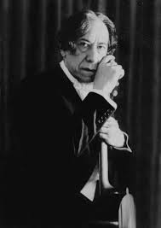
European Art music in paraguay
Paraguayan classical composer and guitarist Agustín Barrios Mangoré, one of the first gramophone-recorded classical guitarists (first recordings in 1909)
“the messenger of the Guaraní race” … “the Paganini of the guitar from the jungles of Paraguay” who epitomized the concept of “heroic individualism” or “artist as hero”
Notes:
Optional audio-visual study: Santo de la Guitarra: La Historia Fantastica de Agustin Barrios Mangore (2012) (with subtitles)
[image credit: Agustin Barrios in El Salvador 1941; provided to author by Carlos Salcedo Centurion]

Slide 9
European Art music in egypt
late nineteenth century: the Golden Age of Arabic modern music
music recording industry enjoyed early success in Egypt
By 1904, recordings were made of Egyptian music, which first included cylinder phonograph records, and later the flat 78rpm disk promoted by companies such as Grammophon, Odeon, Pathé, Columbia, and Bardophone
  commercial sound recording transformed traditional Arab music because record companies favored pre-composed, short, self-contained songs (5 – 6 minute time limit) over long, improvised, interactive live performances
spread of the phonograph among all classes of people, and public phonographs in coffee houses and among mobile disc jockeys throughout the Middle East
recordings by singers of religious and classical texts, the mashayikh, also performing live in musical theaters and music halls
Notes:
Popularised Arab art music has been produced as well as enjoyed in virtually all Arab countries. Beirut (Lebanon) and Cairo (Egypt) were the two main centers for
the production of commercial recordings, and therefore less is known about popular music of Iraq and the Arabian peninsula.
Egypt, has been a principal centre for the development and dissemination of Arab popular music, while Cairo gained early ascendancy in the development of the mass media and the musics associated with them. The country was prompt to take advantage of the new media, notably gramophone, radio, film, and later television.

Slide 10
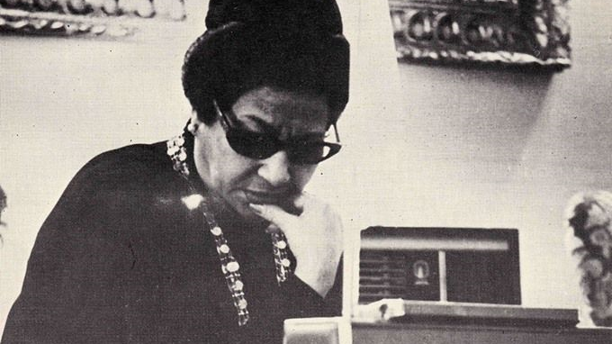
recording industry became extremely attractive to musicians due to the potentially high financial rewards and broad public exposure; to those who successfully negotiated recording contracts, the music recording business was extremely lucrative.
One of the most noteworthy performers and recording artists: Umm Kulthum (1904–1975), a female mashayik singer and superstar of Arab music during the twentieth century
1920s: radio became extremely popular throughout the Arab world, and established stars like Umm Kulthum (among others) were offered first choice in scheduling and regularly performed live
Radio retained its popularity well into the 1960s until the event of the cassette player.
Notes:
[Image credit: Umm Kulthum listening to the radio. Source http://www.middle-east-online.com/?id=245503, accessed 15 March 2018 and reproduced for educational purposes only]

Slide 11
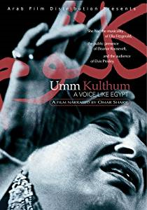
early 1930s: music recording industry promoted the development of film song when musical film became a popular medium an gradually replaced theatre
1950s: increased influence of electronics, mass media, and westernization, combined with an outlook that favored western classical music
By 1960s, television became increasingly popular with broadcasts that included live concerts by Umm Kulthum and other stars
Notes:
Optional audiovisual study: Umm Kulthum: A Voice Like Egypt (1996)

Slide 12
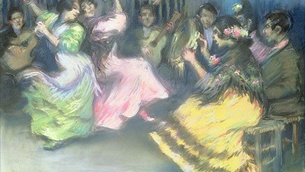
Vernacular Popular Music in Europe
Spanish Flamenco…
  its development to the most urbanized, professionalized form of traditional Spanish music clearly reflects and symbolizes the modernization and urbanization of Spanish culture since the nineteenth century
  shaped by the emerging global economy and tourism
  increasing professionalization and commercialization during the period of musical modernization (1850–1940s) and thereafter
  moved increasingly to festival circuits and concert stages, while national recording studios and multinational firms became actively involved in disseminating the flamenco genre worldwide
  shaped and reshaped through the consumers and the market in the light of exoticism and artistic orientalism of the gypsy culture
  since the 1960s: flamenco fusions, flamenco-pop and nuevo flamenco
Notes:
The rise of modern consumer cultures in Europe since the mid-nineteenth century also witnessed the emergence of local vernacular styles and genres of popular music, such as rebetika and bouzouki music (Greece), arabesk (Turkey), fado (Portugal), flamenco (Spain), Neopolitan rock (Italy), and many others.
Optional audiovisual study: Beats of the Heart: The Romany Trail, Part 1 Gypsy Music into Africa and Part 2 Gypsy Music into Europe (1981); Paco de Lucia - Light and Shade: A Portrait (1994)
Background image: Ricardo Canals y Llambi, Spanish Gypsy Dancers [source: https://www.artble.com/artists/john_singer_sargent/paintings/el_jaleo, accessed 15 March 2018 and reproduced for educational purposes]

Slide 13

Musical modernization in Africa and latin america
Notes:
The rise of modern consumer cultures in other parts of the world in the nineteenth and twentieth centuries led to the development of modern, industrialized music industries around the world. Under the influence of western forms of capitalism, music became increasingly produced and commodified for the purpose of exchange, influencing musical production significantly. This trend paved the way for musical appropriations and importations in many countries, using western cultural idioms, styles, and expressions for musical inspiration. ➔ musical modernization. Musical modernization meant the spread of western influence in many parts of the world.
While European art music influenced musical commodification in the early period, the dominant force, both quantitatively and qualitatively, in world popular music has subsequently been the spread of the “pop-rock aesthetic” (Regev 2013)—pop-rock music
that originates from the US and the UK. New musics blended local and traditional forms with imported Western, norms. Since the 1960s, aesthetic cultures of western pop-rock music have thus been present in countries all over the world.
[copyright-free image credit: https://www.pexels.com/photo/bookcase-bookshelves-bookstore-business-351265/, accessed 15 March 2018]

Slide 14
Afropop
first records made by Grammophon in 1912 in South Africa, followed by Nigeria in 1914
1920s, European companies from Britain, France, and Germany also recorded music in Madagascar, the Gold Coast, Kenya, and others.
1930s, production continued mainly in South Africa due to the growing urban black population with demand for “black” South African popular music
radio played a crucial role in its development of African popular music
post-1945, urban populations grew across the continent and new recording technology ➔ international companies and new local record companies (e.g. Decca, EMI, and Philips in West Africa)
African popular music was released on 78rpm records into the 1960s and sold on local markets and in the capitals of former colonial powers (London, Paris)
The many styles and forms making up the large genre of Afropop reflect and resonate with the many diverse local circumstances and particularities of musicians, performers, and listeners across the African continent.

Slide 15
South africa
Afropop with political commentary… an important category of modern popular music
political songs in S Africa have reflected the liberation struggle under the apartheid system of severe racial inequality and enforced racial separateness
popular musical forms developed within colonialist contexts
commercial aspects of popular music in South Africa have been characterized by white domination, exploitation, and corruption
Amidst apartheid and censorship, black South African musical life continued to develop, and many musicians opposed the dominant system through their music in support of the anti-apartheid political cause.
South African pop music became a powerful tool in the liberation and anti-apartheid struggle.
Notes:
Optional audiovisual study: Amandla! A Revolution in Four Part Harmony (2003); Rhythm of Resistance: Black South African Music (1988)

Slide 16
Brazil
The evolution of Brazilian popular music was influenced by a rich heritage of neo-African music and European genteel light-classical music
In the twentieth century, urbanization and the mass media further influenced the emergence of new syncretic genres, such as samba, which blended European (notably Portuguese) and African elements in such a way as to acquire the status of national music.
Emergence of the urban (commercial) samba: 1917 recording of Ernesto “Donga” dos Santos’ ‘Pelo Telefone’ alongside carnival street samba and other styles
Notes:
In Latin America, popular music emerged as musical fusions, which was bred primarily from fusions of European and African-derived musical elements. The emergence of the mass media greatly expedited such cross-fertilizations and exportations, while recording, broadcasting, and film have played important roles in expanding musical activity.
As Latin America’s largest country, Brazil is an important center of popular music where practically every form of popular music is influenced by traditional music. The country’s recording industry is well-developed, and its market ranks among the top seven worldwide with the big multinationals dominating the field.

Slide 17
The evolution of popular music in Latin America can be seen as the result of the blending of European and African musical elements into new, syncretic music conditioned by urbanization and the mass media, and, with it, intense social and cultural changes labelled under the broad umbrella term of modern globalization.
Notes:
Optional audiovisual study: Brasil, Brasil: From Samba to Bossa (episode 1)

Slide 18
The world was blanketed by mass media and electronic communications during the twentieth century, and populations worldwide experienced intense social and cultural changes, variously labelled westernization, modernization, urbanization, secularization, industrialization, commercialization, commodification, and globalization. New popular music evolved in response to this, which arose from and was marketed to a mass audience of consumers. Popular music typically functions as entertainment in urban environments, and usually shares several traits, such as being “mass-mediated, commodified, syncretic, rapidly obsolescent, and accessible.

