Slide 1
Session 11
Feminism, Resistance, and Popular Music

Slide 2
synopsis
This session continues the focus on the postdemocratic conditions of today’s neoliberal culture and asks important questions about the role of social democratic citizenship, conceptualized here through the role of popular music in democracy and resistance. Resistance is at play particularly through the role played by feminism in popular music within the hegemonic order of the global music business and wider society. Popular music here indeed functions in opposition to the cultural hegemonic norm. Unequal power structures and stereotypical and oppressive role models are being revealed, challenged, and resisted by feminist musical practices, which reminds us of the way that gender and sexuality have assumed constructed meanings that are applied to identity characteristics of others, highlighting the ways in which inequality and prejudice are constructed in the representations of popular music. This session highlights local forms of resistance that challenge global capitalism’s commodification of the gendered other.

Slide 3
introduction
All decent people, male and female, are feminists. The only people who are not feminists are those who believe that women are inherently inferior or undeserving of the respect and opportunity afforded men. Either you are a feminist or you are a sexist/misogynist. There is no box marked “other”. (Ani diFranco 1998)
Notes:
The singer and musician Ani DiFranco once suggested,
All decent people, male and female, are feminists. The only people who are not feminists are those who believe that women are inherently inferior or undeserving of the respect and opportunity afforded men. Either you are a feminist or you are a sexist/misogynist. There is no box marked “other”. (1998)
DiFranco’s words have high relevance in today’s media landscape in which music carries a powerful message and a moral responsibility.
Feminist popular music has functioned in opposition to the cultural hegemonic norm, and in doing so, revealed, challenged, and resisted stereotypical and oppressive role models, and hence unequal power structures. Feminism has attempted to radically challenge women’s place in the global music industry.

Slide 4
feminism
Political mobilization of women, female identities and their political expression
Challenge patriarchy in its evolved form:
“imperialist white supremacist capitalist patriarchy” (bell hooks)
“multi-racial white supremacist capitalist patriarchy” (Robin James)
Notes:
One major form of resistance and disruption to neoliberalism and postdemocracy has been the political mobilization of women.
Historically, women gave little autonomous expression of their demand, given their roles as guardians of the family and lack of organization so not to upset the (gendered) status quo. Indeed, “to articulate a feminine vision is to criticize a masculine one” (Crouch 2004:61).
Since the 1970s, there has been a mobilization of female identities and their political expression, which began with a small group of intellectual and extremists and grew into a major social movement beyond official feminist movements.
The feminist movement has played a significant role in challenging the hegemonic order of the global music business and wider society, as these have been shaped by “imperialist white supremacist capitalist patriarchy” (bell hooks 2004:17) and “multi-racial white supremacist capitalist patriarchy” (Robin James).
Feminism, as it is known today, is a multifaceted and contested term based on the collective belief that “women, purely and simply because they are women, are treated inequitably within a society which is organized to prioritize male viewpoints and concerns” (Gamble 2001:vii).

Slide 5
Historical development of feminism:
Suffragette… first-wave feminism late 19th century
second-wave feminism late 1960s and early 1970s
Feminism became increasingly a movement against sexual oppression, a desire for equal rights for women, and generally a protest against the hegemonic order and, with it, “racism, capitalism, hetero-normativity, classism, and cultural and political imperialism” (Garrison 2004:185).
Notes:
Feminism grew out of the activism that addressed the Suffragette movements of the late 19th century, opposed women’s oppressions in equality, and aimed at changes within society.
Subsequently, steps toward the “women’s liberation” movement were taken by members of left-wing university/college campus organizations in the mid- to late 1960s. Women started their own activist groups, reinterpreting Marxist approaches toward institutionalized power relations (e.g. in education, law, and marriage) in private life, such as domestic work and sexual relationships. The feminist movement became later (from the 1960s until 1980s) known as second-wave feminism.
Feminism became increasingly a movement against sexual oppression, a desire for equal rights for women, and generally a protest against the hegemonic order and, with it, “racism, capitalism, hetero-normativity, classism, and cultural and political imperialism” (Garrison 2004:185). Pragmatic second-wave feminist thought focused on equality and saw political areas, such as equal pay and career opportunities, as essential. Feminist theories and practices thus have become hugely diverse.
Second-wave feminism has often become criticized for falling into the trap of agreeing with patriarchal ideology, that is, a general assumption that the areas in which men dominate are of most value. Consequently, second-wave feminism “encouraged women to become like men” (Whiteley 2000:76), a view challenged later by postfeminism.

Slide 6
Feminism’s impact on popular music
During the 1960s, the impact of feminism on popular music was certainly limited
male dominance in the rock music business continued in both the representations and musical careers of female rock stars
the dissemination of female artists’ public image remaining in the hands of male gatekeepers of popular culture
during the mid- to late 1970s, despite feminist advancements, music journalism continued to represent female musicians in this way.
Notes:
During the 1960s, the impact of feminism on popular music was certainly limited. While prior to rock ‘n’ roll, music performed by women made up one third of all single sales, with the arrival of rock music (and after the British rock invasion into the US), female artists’ sales decreased to 6% of the top 50 singles in 1969 (Chapple and Garofalo 1977:277). Similarly, the number of pop songs that implied sex, and the number of females as initiators significantly increased between the 1960s and 70s. In much pop music, women were portrayed as sex objects to be directed at the male gaze. Thus, male dominance in the rock music business continued in both the representations and musical careers of female rock stars, and female music artists of the counterculture era suffered due to the dissemination of their public image remaining in the hands of male gatekeepers of popular culture. The late Sheila Whiteley explained that “both the lifestyle and the musical ethos of the period undermined the role of women, positioning them as either romanticized fantasy figures, subservient earth mothers or easy lays” (2000:23), and during the mid- to late 1970s, despite feminist advancements, music journalism continued to represent female musicians in this way.

Slide 7
The struggle for women can be located within the dichotomous binary between “masculine authenticity” versus “female artificiality”, and the construction of women as “fragile pop singers” that limited and marginalized them to the status of backing singers in the world of rock (Coates 1997:53).
In neoliberalism, women also continue to be disadvantaged in employment in the cultural sector, who have typically remained near the bottom of corporate hierarchies, with comparatively few women in position of power and control (McGuigan 2009:184; McRobbie 2016).
Notes:
Thus within the dominating hegemonic practices in the music industry, women who embodied feminist ideologies, whether consciously or subconsciously, found it hard to be taken seriously in a music business dominated by men and tackled this problem in various ways.
Early blues singers of the 1920s like Bessie Smith Janis challenged lingering nineteenth century beliefs that women were naturally, passive, pure, and passionless (Sheehan 2017). They also refused to be defined by negative white/black stereotypes that equated black women as hypersexual. The subject of Smith’s blues included queer desire, infidelity, and intimate partner violence.
Blues women also paved the way for gender bending, playing with bisexuality and queer desire long before Little Richard, David Bowie, Grace Jones, Annie Lennox, and others. Joplin, for example, adopted masculine traits at the expense of her feminist qualities in order to be accepted within the rock music genre at the time, regardless of her singing talent and strong personality. For women to represent hard, aggressive performers, it was thus necessary for artists like Janis Joplin to be branded as “one of the boys” (Leonard 2007:37), with descriptions of her physical appearance often demoting her looks to the realms of strange, unattractive or even abnormal in an attempt to limit the disruptive potential of her self-assured sexuality and confidence.

Slide 8
FEMINIST MOVEMENTS AND MUSICIANS
Examples of female recognition, participation and empowerment:
Feminist support networks
women-targeted music
new women-run music businesses
Chard Festival of Women in Music in England, New Zealand Composing Women’s Festival
Australian Women in Pop Magazine
Notes:
Even so, feminist popular music has functioned in opposition to the cultural hegemonic norm, and in doing so, revealed, challenged, and resisted stereotypical and oppressive role models, and hence unequal power structures. Feminism has attempted to radically challenge women’s place in the global music industry.
Feminism did encourage female artists to participate in popular music. Some examples:
Feminist support networks to support female participation in popular music by providing material resources like musical instruments and technology, training, as well as confidence.
During the late 1960s/early 1970s in both the US and Great Britain, women-targeted music with feminist and lesbian lyrics emerged by feminist support networks .
growing trend toward establishing women-only groups, workshops, rehearsal, dance and performance spaces, all of which reflected a sense of feminist collectivism and community among female musicians (Cohen and Leonard 2003:75).
During the 1970s, new women-run music businesses were established, such as Olivia Records (1973) in the US.
music festivals that showcased the work of female musicians, including the annual Chard Festival of Women in Music in England, promoting folk, classical, jazz, and contemporary music; the New Zealand Composing Women’s Festival with concerts showcasing a vast array of styles from jazz to opera to hip hop; or Michigan Womyn’s Music Festival, an event completely built, staffed, and run by women.
A very current example of female empowerment is the Australian Women in Pop Magazine, with the first issue published in 2017, which is dedicated to giving female pop artists from around the globe “the attention they deserve” (Women in Pop 2017) with the aim of reversing the “injustice towards female musicians” (Dawson 2017).
Image credit: Screenshot of homepage of Women in Pop. Available at http://www.womeninpop.com/, acsessed 27 March 2018.

Slide 9
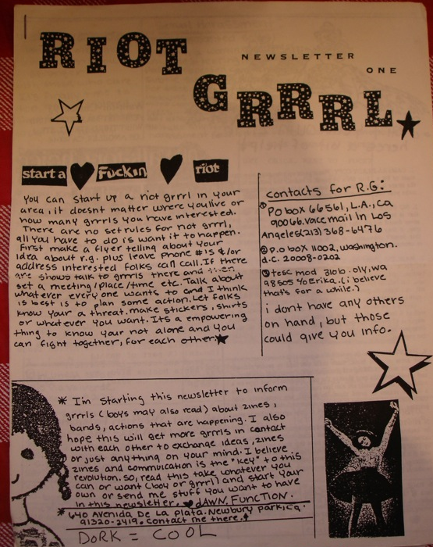
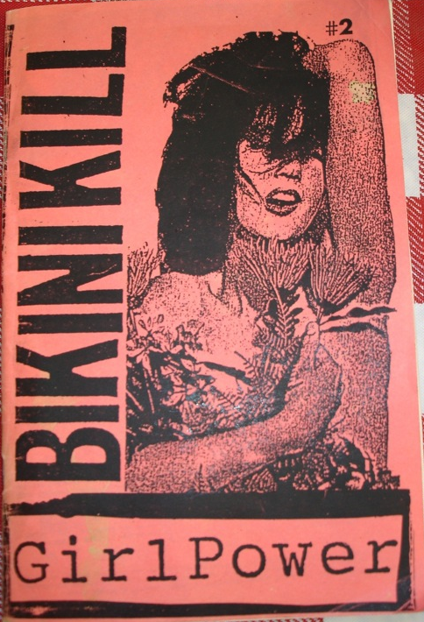
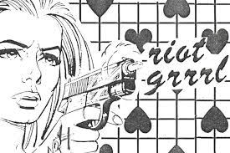
Notes:
During the early part of the 1990s, a feminist networking group labelled “Riot Grrrl” became promoted by musicians and performers within the underground rock music communities of Olympia, Washington, and Washington D.C. in the US.
Riot Grrrl aimed to empower girls and women, enlighten them to the prospect of becoming involved in the production of music, and to challenge restrictive gender roles that had previously deterred the participation of women in the rock music scene (Leonard 1997). Often associated with third-wave feminism, Riot Grrrl is an underground feminist hardcore punk movement that foregrounded women’s involvement in the music making process. The Riot Grrrl movement actively sought to challenge the dominant roles of males.
Riot Grrrl soon expanded its network to the UK, Canada, and other regions within the US.
It resulted in the establishment of extensive (print and electronic) “zine” networks and an abundance of dedicated Riot Grrrl websites, and the creation of numerous female-centered punk rock bands. Besides female empowerment, riot grrrl bands often addressed issues such as rape, domestic abuse, sexuality, racism, and patriarchy.
Connections to punk music underpinned the DIY culture and “amateurist ethos” inherent in punk were a catalyst for the Riot Grrrl movement in the US.
Punk was identified with notions of resistance not only musically, but also in terms of its distinct fashion and lifestyle, while challenging—visually—the mainstream culture by standing out from the crowd and be noticed. Through mode of dress, which typically consisted of school uniforms combined with bunched hair and ribbons representative of childhood, riot grrrls sought to challenge traditional conventions of beauty and femininity. “Hello Kitty” accessories were particularly popular due to the cat motif’s association with childhood, even though the brand was thoroughly entwined in western capitalism.
Many riot grrrls bands labelled their bodies with words like “slut” and “whore” as both a protective and assertive means of communication.
Image credits:
A Brief Visual History of Riot Grrrl Zines. 2010. Available at http://flavorwire.com/128822/a-brief-visual-history-of-riot-grrrl-zines/3, and
https://flavorwire.files.wordpress.com/2010/11/riot-grrrl-newsletter-1.jpg, accessed 27 March 2018.
She Came to Riot. 2013. Available at https://www.jacobinmag.com/2013/09/she-came-to-riot/, accessed 27 March 2018.

Slide 10
Don't need you to say we're cute
Don't need you to say we're alright
Don't need your protection
Don't need no kiss goodnight
Don't need you don't need you
Us girls don't need you
Don't need you to say we're good
Don't need you to tell us we suck
Don't need your atti-fuckin-Tude boy
Don't need your dick to fuck
Does it scare you that we don't need you?
Does it scare you boy that we don't need you?
Don't need you don't need you
Us punk rock whores don't need you
Notes:
One of the most prevalent impacts of the riot grrrl movement occurred within the musical sphere.
During the peak of the riot grrrl movement, some of the pioneering riot grrrls bands (e.g. Bratmobile, Bikini Kill) worked with large record labels like K Records, thereby gaining a higher level of exposure in both the independent and commercial press.
Yet in order to challenge and undermine the capitalistic working practices of major record labels and their corporations, many riot grrrl bands started their own indie labels, most notably Mr Lady (formed by Kaia Wilson and Tammy Rae Carland) selling female-produced media, including music and film, with “bigger” bands like Bratmobile and Bikini Kills later also forming collaborations with independent record labels and subsequently forming their own indie labels (Kearney 2006).
Lyrically, riot grrrl bands were confrontational, while challenging male dominance combined with confrontation and dismissal. For instance, many of Bikini Kill’s songs are concerned with “sexual and physical abuse of women”, while also tackling “girls’ concerns about being unable to meet society’s beauty standards and ideas of femininity” (Bock 2008:91).
The lyrics of “Don’t Need You” (1994) by Bikini Kill provide an interesting example in this context, while also reworking crude words like “whore” that many riot grrrls displayed on their bodies as a protective strategy.

Slide 11
Notes:
Optional audio-visual study: Don’t Need You – The Herstory of Riot Grrrl. Available at https://youtu.be/be5YcNT7jVk, accessed 27 March 2018.

Slide 12
Notes:
Early festivals operated as a catalyst for inspired action between females, while encouraging females to actively involve themselves in music and form their own bands. The last “official” Riot Grrrl conventions were held in 1995 in Los Angeles and Chicago (e.g. Midwest Girlfest), and in 1996 in Santa Barbara, Seattle, Portland, Philadelphia, and New York.
Since the mid-1990s, the riot grrrl movement splintered due to the mediated misrepresentations of its core message. The feminist movement had been co-opted by the music business and its politically radical aspects had been subverted by the Spice Girls’ adoption of the “girl power” message.
Nonetheless, similar gatherings inspired by the riot grrrl movement have been held since, notably the Ladyfest Art Festivals in cities worldwide; the queer-art Homo A Gogo festivals on the West Coast; and the annual Southern Girls Conventions (from 1999 until 2008).
Ladyfest first emerged in 2000 “in commemoration of riot grrrl” (Leonard 2007:163) as a week-long event comprising art, performance, and musical activities. Its primary objective was to increase the presence of female musicians within indie and punk music scenes. In 2001, Ladyfest was held three times in the US, followed in 2002 by nine events in the US, which triggered a rise in awareness and geographical spread as far as Indonesia and South Africa. The festival organizers developed a website to promote the Ladyfest brand to potential festival coordinators, which since led to more than 100 Ladyfest events being held globally.
A spin-off is the all-female rock music camp, which originated in Portland, Oregon, in 2001 and is now a global phenomenon, offering music lessons, workshops, instrument maintenance, silk screening band T-Shirts, magazine making, and the like. The Girls Rock Alliance is the global umbrella organization that unites the camp leaders across the world, while Girls Rock Foundation, headed by artists like Tegan and Sara, Kathleen Hanna, and Beth Ditto raises funds for the camps.
Image credits: Flyers advertising the Laugh Riot Grrrl Festival (2017) and Ladyfest Festival (2009)

Slide 13
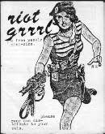
Notes:
The riot grrrl movement also gained momentum and popularity through a variety of media, most notably a network of zines.
Zines were often handwritten by individuals, including hand-drawn sketches and embellishments, incurred inexpensive production through photocopying, and were circulated during riot grrrl performances, by post, and later electronically.
Some zines adopted names like “Bitch”, “Angst Girl”, and “Odd Girl Out”, thereby posing an aggressive challenge toward traditional notions of femininity, and often used alternative (incorrect) spellings like “luv” and “womyn” to challenge notions of conformity to middle-class expectations (Kearney 2006:160-63).
Importantly, zines have resisted corporate co-option by being self-produced in small quantities and distributed within the alternative feminist community for no/minimal profit.

Slide 14
The riot grrrl movement opened the punk scene to females and helped reclaim its performance space for female musicians and audiences alike, notably also by participating in slam dancing on the mosh pit, the area directly in front of the stage, thereby challenging their supposed prohibition toward male counterparts. Riot Grrrl also provided a safe space to hear the voices of victims of crime and actively contributed to safeguarding, protecting, and supporting females. Riot Grrrl provided many females with the impetus to form bands, collaborations, and networks with similarly-minded females. In doing, so, riot grrrl imparted significant empowerment to females.

Slide 15
Notes:
Optional audio-visual study: The Punk Singer (2014)

Slide 16
Feminist Arabpop & afropop
Notes:
Arab women have often been stereotyped as passive, voiceless, politically apathetic, and religiously repressed. But Arab women have long been committed to fighting for a more equitable society as active political players in trade unions, grass roots activism, and other political organisations. Social movements around the Middle East have thereby challenged preconceptions of the traditional role of women (Khan 2011). Arab pop, too, serves as a powerful avenue for Arab feminist expressions.

Slide 17
Notes:
A recent example has been the music video for “Hwages” (2017), translated as “Concerns” and interpreted by some media outlets as “God, Rid Us of Men!” (Desk 2017). The song was directed by singer Majed al-Esa who works for the Saudi production company, 8ies Studios. His latest song “Hwages” with its critical lyrics and symbolic visuals that small patriarchy and misogyny has been hailed as a feminist anthem from Saudi Arabia across the region.
The song has taken the internet by storm, being branded disgusting, offensive, and extremely inappropriate by some viewers (Hughes 2017; Godden 2017), as well as receiving critical acclaim from parts of the Saudi community: “The new generation of women [that] is different from the past”, according to one of the oldest newspapers in Saudi Arabia, Al-Bilad (Elizabeth 2017; O’Malley 2017).
To many feminist thinkers, the song and video celebrate female empowerment and rights, and deliver a “stark political and cultural message about the perception and freedom of women, most notably in a country that asks them to wear ‘modest’ clothes, limit their interaction with men, forbids them from opening a bank account without a male guardian or driving their own cars and often shames them for competing in sports.” (O’Malley 2017)

Slide 18
Notes:
Gender inequality is similarly an issue across the African continent, an issue that is being addressed by the latest “République Amazone” (2017) by supergroup Les Amazones d’Afrique, a collective of twelve female west African musicians.
Collectively, they are campaigning for gender equality and voicing their discontent against gender inequality and patriarchy in west Africa, including polygamy, forced marriage, sexual violence, abuse, and domestic violence. The songs tackle love, oppression, and female empowerment of women across Africa. Moreover, their crowdfunding campaign helps finance the work of Panzi Foundation, led by Doctor Mukwege in Bukavu (DRC), which has provided healing support to more than 80,000 women, nearly 50,000 of whom are survivors of sexualized violence (Real World Records 2017).
Audio-visual study [embedded hyperlink]/image credit: Screenshot of République Amazone by Les Amazones d'Afrique, 2017. Real World Records. Available at https://realworldrecords.com/release/669/republique-amazone/, accessed 27 March 2018.

Slide 20
conclusions
Feminist musicians around the world have related their practice to the values of democracy. They believe in the democratic nature of music and their musical practices in their fight for particular kinds of freedom and equality.
In the age of global capitalist hegemony, postdemocracy is seeing unprecedented opportunities and challenges for humanity, which require us to learn from the tragic mistakes of the past. Postdemocracy renders significant a belief in proactive means of justice delivery, to which feminism has made a critical contribution.
Notes:
Clearly, the feminist movement and its musical practices must be placed within this context. In their music, they address fundamental problems of social justice and difference in neoliberal democracies, which have historically assimilated difference and are deeply embedded in the dualistic thinking in western culture through which the other is colonized by a variety of processes. Popular music thereby engages deep, fluid energies of civil society by modelling a concrete democratic conversation that embraces humanity, justice, and equality.
Feminism is a social justice movement, in which social justice is regarded as a positive, context-specific designation.
In the age of global capitalist hegemony, postdemocracy is seeing unprecedented opportunities and challenges for humanity, which require us to learn from the tragic mistakes of the past. Postdemocracy renders significant a belief in proactive means of justice delivery.
As a global community, if it indeed exists, we need to place renewed emphasis on the ties that bind humanity together and on the need for international cooperation to meet the challenges that humanity faces so to fulfil humanity’s potential. This can only be made possible if all sectors of society, including those whose rights are denied, can meaningfully participate in cooperation, while addressing the plight of those whose rights are most acutely denied.
The challenge in global capitalist hegemony is to generate greater understanding and awareness of humanity and human rights, and to transcend toward social forms of democracy globally. Such a commitment would be an integral component of postdemocratic ideology.

