Slide 1
Session 12
Black & White Nationalism in Popular Music

Slide 2
synopsis
We are at the historical point of postdemocracy, which raises questions about the idea of active democratic citizenship, and how this activism is mobilized though and manifested in world popular music practices. Democracy and resistance are at play through the role played by the civil rights and anti-racism movements in popular music within the hegemonic order of the global music business and wider society. Anti-racist, anti-capitalist popular music indeed functions in opposition to the cultural hegemonic norm, challenging unequal power structures and stereotypical racialized role models. This session highlights local forms of resistance to the spread of white supremacist patriarchal culture, beliefs, practices, and norms, considering musicians animated by social justice, who challenge global capitalism’s commodification of the racialized other. Yet, troubling as it may seem, neoliberalism has also led to periodic outbreaks of conservative, nationalist, right-wing socialism, and some popular music has served as a powerful means to negotiate, express, and model ethnocentric political identities. When aligned politically with the “Right”, such popular music is often most directly concerned with right-wing socialism and white nationalism. Some of these movements do, of course, raise concern and questions regards their compatibility with democracy. Yet they do share with the anti-globalization movement a discontent with postdemocracy, internationalism, and the consequences of uncontrolled global capitalism.

Slide 3
Black Nationalism
Black nationalism… a response to white power and resistance to white hegemony
Hip hop as a counter-hegemonic response to white power
Rap music depicts the cultural “reality” of black men’s experience in relation to the police and challenges unjust authoritarian practices
the critical “voice of underclass youth” (hooks 1990:75)
Technology and sampling as anti-capitalist practices
Notes:
Besides resistance to gender inequality and masculine hegemony, race is often used in various contexts to fabricate “authentic” notions of blackness and, in some cases, black nationalism as a response to white power and resistance to white hegemony.
While some commercialized hip hop serves the powerful white male-dominanted corporations to construct negative stereotyped representations of black youth, much rap music in fact also depicts the cultural “reality” of black men’s experience in relation to the police and challenges unjust authoritarian practices. Regarded as the critical “voice of underclass youth” (hooks 1990:75), some rappers deliberately create hip hop as a counter-hegemonic response to white power.
Hip hop’s rap carried a “‘message of disaffection and rage’ associated with alienated youth in the inner cities of the United States” (Connell and Gibson 2003:132). The lyrics are crucial in evoking “the anger and violence of inner-city life” (ibid.:133).
Technology was paramount too, as DJs began to experiment with different records, voices, and sounds (e.g. sampling), which was in part influenced by Jamaican DJ music cultures. One of the pioneers of developing this eclectic mix of musical elements included Afrika Bambaataa, and the first commercial records started to be released in 1979, a key record being Rappers Delight by The Sugarhill Gang (1979) and The Adventures of Grandmaster Flash on the Wheels of Steel by Grandmaster Flash (1981).

Slide 4
In its development, early hip hop can be seen as a challenge to the authority and legitimacy of specific state systems, including repressive, post/colonial, nationalist, and capitalist structures. Much rap music has since been a means for liberatory expressions and other nationalisms.
Notes:
Black nationalism acknowledges and celebrates a pan-African identity across different cultural forms, including music, and provides “a potent post-colonial demand for radical emancipation from oppressive social circumstances.
Black nationalism embraces ideologies that emphasize an intense identification with an imagined ideal nation. It is an ideological response to a perceived mismatch between reality and an imagined ideal nation, a kind of imagined community that is tied together through imagined allegiances, commonality between its members, and faith.
While nationalism as a political ideology first emerged in the nineteenth century in Europe, localized musical traditions and popular music practices have played a key role in nation state building projects through their nationalist appropriations. Various forms of rap music exemplify this shift in nationalist musical practice, which is reflexive of the “new” musical nationalisms that have emerged in recent decades. These “new” nationalisms are often “articulations of a post-colonial predicament”, in which the West constructed an image of the former colonies as “subaltern”, that is, the consumable, available, conquerable Other, but also constructed an image of forcibly moved, dispossed, and disloacted black people, who, in the aftermath of the abolition of officially sanctioned racism, had to negotiate an identity for themselves that both rejects this history and simultaneously embraces the trauma of that history.

Slide 5
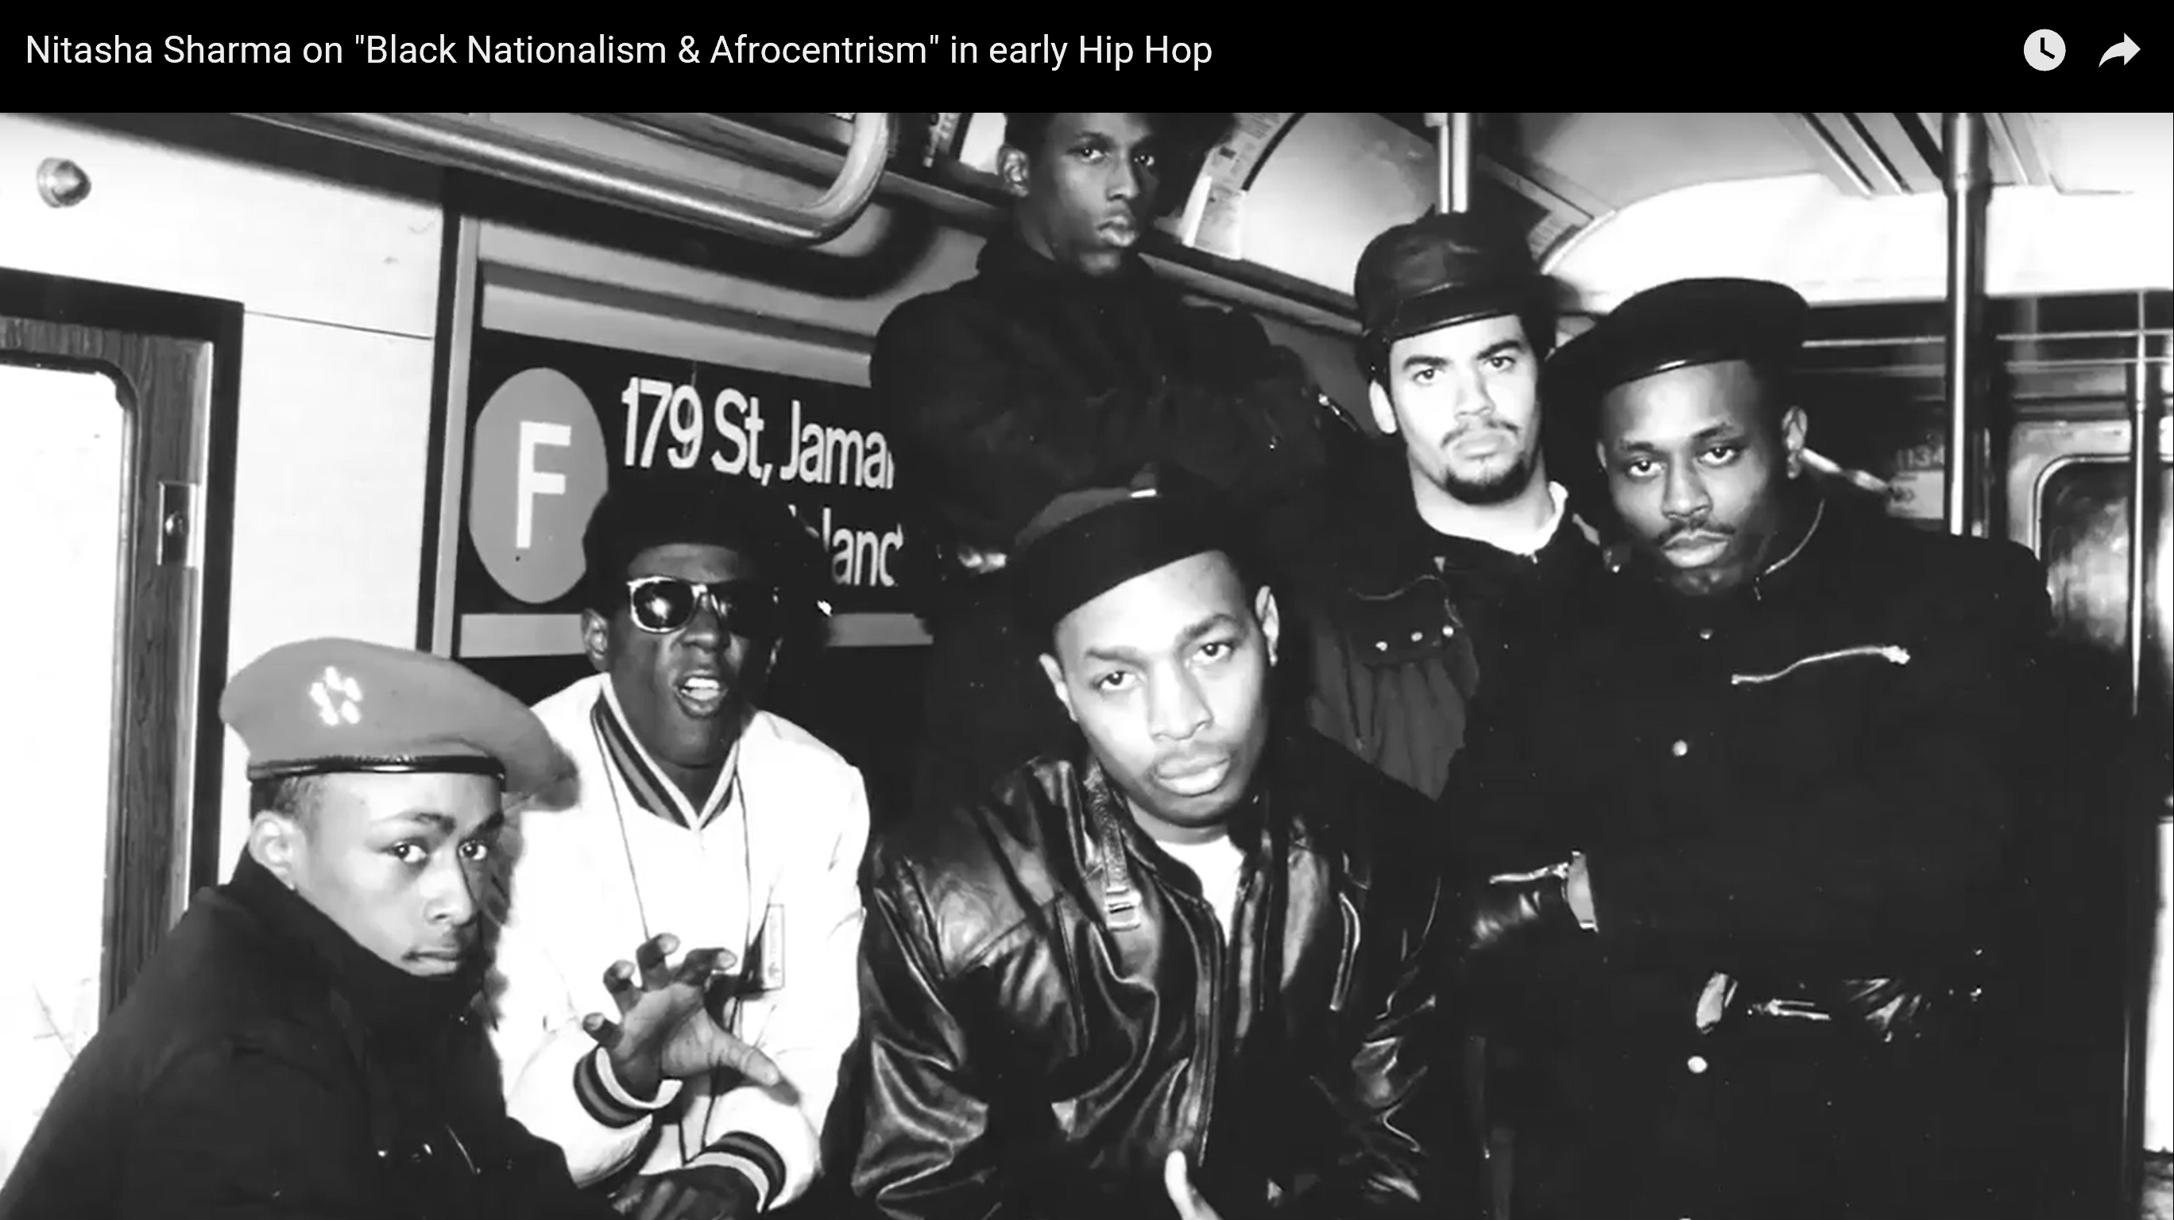
Notes:
Black nationalism is therefore a response to White extrinsic racism that meant the systematic oppression and economic exploitation of people who are not classsified as white, and the infliction of suffering on people of all racialized classifications.
Black nationalists of the 1960s advocated “racial solidarity”, which carries the language of intrinsic racism, while using race as the basis for moral solidarity, which is most commonly expressed in varieties of Pan-Africanism. Pan-Africanism presupposes that black people are being of the same race. Black Nationalism is thereby based on a shared race that provides the basis for solidarity, and where racism is implicated, it is intrinsically applied in its nationalist discourse. One of the founding members of Black Nationalism, Alexander Crummell, utilizes the metaphor of the family and family feeling to exemplify the meanings of a shared race and race feeling, similar to feelings of community.
This is the type of Black Nationalism expressed by Chuck D and his hip hop group Public Enemy.
But there is also at least one other type of Black Nationalism, and Nitish Sharma provides a useful insight into the subtle differences.
Audio-visual study: Nitasha Sharma on "Black Nationalism & Afrocentrism" in early Hip Hop. 2015. Available at https://www.youtube.com/watch?v=84XWrz4cxxM, accessed 28 March 2018.
Image credit: Screenshot from (above) documentary. Reproduced for educational use only.

Slide 6
Chuck D, frontman of Public Enemy
Notes:
Audio-visual study: Chuck D: Pop and Politics (2014)
Further optional study: Bigger than hip-hop : music and politics in the hip-hop generation. 2009. Available at https://repositories.lib.utexas.edu/handle/2152/7555, accesed 28 March 2018.
Chuck D, frontman of Public Enemy, delivers a highly charged black nationalist rap. Also known as “lyrical terrorist”, Chuck D has been acknowledged as the inventor of political hip hop. Chuck D is often regarded as “rap’s sharpest, deepest thinker”, who in the late 1980s started off with his rap group Public Enemy, while stirring up hope (or fears) that “hip hop could affect a revolution in American culture, arousing the anger of dispossessed black people by talking politics over unsettling grooves” (Morley and Evans 2004:2:00-2:30).
Chuck D is driven by an idealistic vision of a black community informed by the belief in the transcendence of race. He grew up in a decade of radical political change, following the civil rights protests that finally effected equal rights for black people after 150 years of slavery and discrimination.
The 1960s until the 1980s were marked by Republican right-wing politics that were detrimental for the black communities, described by Chuck D as “R&B, Reagan and Bush”. Hip hop became soon recognized for its potential and power. In 1986, Public Enemy were signed by Deaf Jam, which marked the beginnings of radically blistering rap against the “powers that be”.
As hip hop became hyper-commercialized in the early 1990s, Chuck D continued to be the “militant mouthpiece for an abstractly violent form of Black Nationalism that owes its uncompromising stance to the Black Panthers” (Morley and Evans 2004:16:00-16:15). Moreover, when the “illegal” downloading of music first became an isssue, Chuck D challenged the music recording industry, and Public Enemy became the first multi-million selling band who put their album online for free. Public Enemy’s music thus functioned as a form of resistance to both racist and capitalist hegemonic structures. Expressions of black nationalism in the West celebate hip hop as something positive that can open people’s minds, and at the same time reflect efforts toward “cultural linkages and unity throughout the diaspora, alongside demands for a more prominent place within the nation” (Connell and Gibson 2003:137). In doing so, black nationalist hip hop has given a voice to the minority inner-city African American community that enables and celebrates black ethnic pride, even within the constraints and implications of a global capitalist music market. According to Tricia Rose,
[Public Enemy’s] ability to retain the mass-mediated spot light on the popular culture stage and at the same timee function as a voice of social critique and criticism [is what makes them] prophets of rage with a difference. (Rose 1994:100)

Slide 7
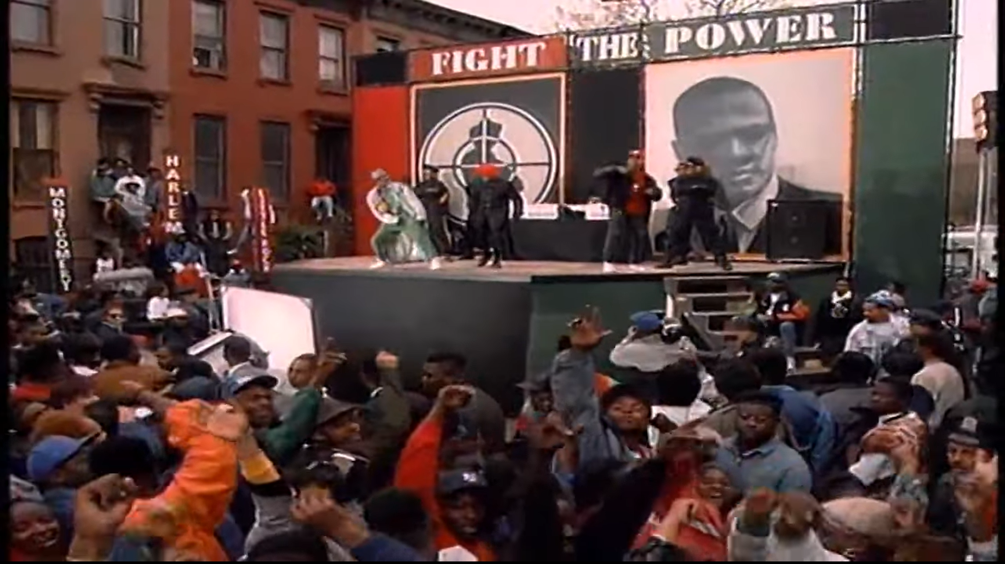
Notes:
Public Enemy’s song “Fight the Power” (1989), recorded for the Spike Lee movie Do the Right Thing (1989) rendered Chuck D a spokesperson for a whole generation of profoundly alienated young black people.
Hip hop became a form of political activism that addressed issues of police brutality, education, and other issues in black culture. Chuck D viewed hip hop as black people’s CNN, a genuine political threat to the “powers that be”, which they represented musically, visually, lyrically, and personally. For instance, Chuck D’s affiliation with the nation of Islam and Black Separatism, which sanctioned Islamic fundamentalism, represented a serious threat to the hegemonic political and economic order in the US.
Audio-visual study: Public Enemy ‘Fight the Power’ (official version). Available at https://youtu.be/Kj9SeMZE_Yw, accessed 28 March 2018.
Image credit: Screenshot from above music video. Reproduced for educational purposes only.

Slide 8
Black expressive culture thereby conveys black nationalist political signifiers in its role to resist the hegemonic cultural order, while articulating numerous anti-capitalist and anti-racist aspects (Paul Gilroy 1987,1993; quoted in Longhurst 1995:132), including a
critique of productivism, work, the labour process, and the division of labour under capitalism; a critique of the state revolving around a plea for the disassociation of law from domination, which denounces state brutality, militarism and exterminism; [and] a passionate belief in the importance of history and the historical process which is presented as an antidote to the suppression of historical and temporal perception under late capitalism. (Longhurst 1995:132).
Notes:
Since its conception, political issues were thus at the heart of much hip hop, including raps about the denigration of black history, and the current exploitation of black people. Indeed, “hip hop theoretically served to distribute the critical narratives of an isolated working class and underclass youth culture across the disjointed African-American diaspora via the marketplace” (Neal 1999:160).

Slide 9
Hip hop is an example of popular music through which cultural identities surrounding blackness are modelled, reflected, and negotiated. While hip hop emerged from black and Hispanic neighbourhoods of American cities in the 1980s, it involves not only questions of ethnicity, but also political orientations, gendered discourses, class thinking, and nationalism.
Notes:
Their anti-capitalist resistance occurred particularly through the creative mixing, cutting, and scratching by DJs, and toasting by MCs, whereby commodities of the music industry (e.g. Led Zeppelin, Kraftwerk) were “hijacked”, reused, and appropriated into social spaces of pleasure and expression.
Indeed, “rap constructs and reconstructs a black community which reinterprets the pre-existing forms of culture in a far more radical way… in a widely circulating form of music” (Longhurst 1995:156).

Slide 10
Resistance to Global Capitalism, White Nationalism, and Popular Music
Notes:
In addition to feminist and anti-racist expression of democratic citizenship, social identities in response to postdemocracy are also mobilized by groups engaged in violent and no-global anti-capitalism campaign, racist organizations, and others. Some of these movements do, of course, raise concern and questions regards their compatibility with democracy. Yet they do share with the anti-globalization movement a discontent with new forms of democracy, internationalism, and the consequences of uncontrolled global capitalism.

Slide 11
Fascism….
a form of conservative, nationalist, right-wing socialism associated with anti-bourgeois, anti-democratic, anti-liberal, and anti-Marxist views.
Some right-wing movements have used right-wing socialism to describe support for social solidarity.
seek to maintain the white status quo by preventing free-market entrepreneurship and “creativity”
“right” popular music is often most directly concerned with right-wing socialism and white nationalism
Notes:
In the present-day construction of global hegemony, there have been various periodic and undoubtedly troubling outbreaks of neoconservative atavism that are close to and bear resemblance with fascism.
Fascism is a form of conservative, nationalist, right-wing socialism associated with anti-bourgeois, anti-democratic, anti-liberal, and anti-Marxist views.
Some right-wing movements have used right-wing socialism to describe support for social solidarity as opposed to individualism, commercialism, and laissez-faire economics. These movements seek to maintain the white status quo by preventing free-market entrepreneurship and “creativity” from disrupting the pre-established framework of social organization within global capitalism.
In contemporary youth cultures, popular music is a powerful means to negotiate, express, and model ethnocentric political identities. When aligned politically with the “Right”, such popular music is often most directly concerned with right-wing socialism and white nationalism.

Slide 12
The “Right”
The political terms “Right” and “Left” emerged in late eighteenth century Europe
In English-speaking countries, “right” and “left” politics emerged in the twentieth century
The right considers some forms of hierarchy and social inequality as inevitable, even desirable, on the basis of biology, economics, or tradition.
The right also includes neo-conservatives, authoritarians, nationalists, fascists, racial supremacists, Christian democrats, religious fundamentalists, and classical liberals.
Differentiation between the “mainstream right” and “extremist right”
Notes:
The political terms “Right” and “Left” emerged in late eighteenth century Europe and referred to two sides in the French parliament, whereby politicians sitting on the right were broadly supportive of traditional conservatives, monarchists, and reactionaries. In English-speaking countries, “right” and “left” politics emerged in the twentieth century following the general economic shift toward capitalism with center-right movements, such as the British Conservative Party, becoming supportive of capitalism. By contrast, in the United States the “right” is an integral part of the conservative movement in the U.S., notably in American politics in the Age of Reagan since 1980.
Generally, the right considers some forms of hierarchy and social inequality as inevitable, even desirable, on the basis of biology, economics, or tradition.
Nowadays, the right also includes neo-conservatives, authoritarians, nationalists, fascists, racial supremacists, Christian democrats, religious fundamentalists, and classical liberals. For instance, some writers differentiate between the “mainstream right” and “extremist right”:
mainstream right is used to define more established conservative forces, which became increasingly powerful and present internationally since 1978-80, the years in which first Thatcher became British premier and Reagan US president.
there is no major firewall between the extremist right and the mainstream right. The “extremist right” is often defined differently, as typologies are nationally specific and change in different contexts and time periods.
In Britain, new groups of far right extremists deliberately target children and teenagers online, seeking to recruit a new, younger generation of members who are invited to take part in day excursions, while posing with the right-wing groups’ banners and Neo-Nazi emblems (Griffith 2015). Meanwhile, key players on the far-right scene like Steve Cartwright, former member of the ultra-extremist group Combat 18 and co-organizer of white power gigs in Britain under the banner of Blood and Honour, is
partly responsible for bringing a concept called “Project Schoolyard” to Britain, which involves activists handing out free CDs of white power music to children outside schools. In the USA, Project Schoolyard was kick-started by the white power label Panzerfaust – named after the anti-tank bazooka used by the Wehrmacht in the Second World War. (Mackay 2006; Manson and Mackay 2006).

Slide 13
“right” music – white power music
The “typical” right rock fan is white, masculine, and below thirty years of age, who listens to the music for political, musical, and other reasons (Farin 1995:3). Skinheads are only one part of the right rock scene; right rock is also the music of death metal fans, goths, dark wave fans, as well as “normal” youth.
Notes:
For example, right bands like Landser and Zillertaler Türkenjäger are often well-known among ordinary school children in Germany (Schmidt 2002), who may identify with the band members who come from the same living conditions as these fans, and admire them as idols and stars.
There even is a trend among youths to turn to right-wing extremism as a form of rebellion, and thereby absorb neo-Nazi fashion, music, and ideology as an ever important part of German youth culture (Cziesche et al. 2005).

Slide 14
The desire for youth rebellion is clearly recognized by the producers of white power music:
Young people love anything that is seen as rebellious – so when the social workers and the teachers and the parents go “that’s taboo”, the hope is that young people always rebel, and in our opinion if they are going to rebel, we would like them to do it our way and to listen to our music. (David Hannam, Managing Director of the BNP-owned label Great White Records; in Mackay 2006)

Slide 15
censorship
In both Europe and the United States, music has since the 1990s become one of the most important means to distribute extremist right ideologies among young people…. Thus, strict state control and censorship of bands, distribution, and Skinzines in numerous Europea countries!
Notes:
In both Europe and the United States, music has since the 1990s become one of the most important means to distribute extremist right ideologies among young people. This is made possible through the internet that enables (often) illegal music production and distribution, and through mobile phones that help surreptitiously organizing illegal concerts (Mackay 2006; Manson and Mackay 2006).
The right-wing music scene has become subject to strict state control and censorship of bands, distribution, and Skinzines in numerous European countries, notably Germany and Italy with their experience of fascism in the past seventy years, who seem more intuitively attuned to the question of “free speech” and “action” among rightist extremists.
Germany, for instance, has in place explicit laws banning Holocaust denial, the formation of explicitly Nazi Parties, and other extremist Right activities (Bundesamt für Verfassungsschutz 2015a).
The increased state censorship of right rock was particularly effective in the area of concert organization (Farin 1995:4-5).

Slide 16
Neo-Nazis… are on the rise across Europe and in the United States. In Britain, the British National Party won more than 800,000 votes at the last European elections. In Germany, they have seats in state parliaments and are doing better, electorally, than at any time since the Second World War. Italy is also seeing a marked upswing in votes for the far right. Increasingly central to the political success of parties such as the German NPD – the political grandchild off Hitler’s National Socialist German Workers Party – and the BNP is white power music. Bands include Whitelaw, Strike Force 28 and Grinded Nig (whose album Freezer Full of Nigger Heads features songs such as “Jackhammered Nigger Pusy”). Their records are available from most neo-Nazi record distributors online. (Mackay 2006)
Notes:
Even so, British bands’ popularity is little affected by such bans, and bands like Whitelaw and Nemesis bring out music with clearly radical lyrics, which can still be purchased by German fans. For instance, recent journalistic discourse reported that,
Neo-Nazis… are on the rise across Europe and in the United States. In Britain, the British National Party won more than 800,000 votes at the last European elections. In Germany, they have seats in state parliaments and are doing better, electorally, than at any time since the Second World War. Italy is also seeing a marked upswing in votes for the far right. Increasingly central to the political success of parties such as the German NPD – the political grandchild off Hitler’s National Socialist German Workers Party – and the BNP is white power music. Bands include Whitelaw, Strike Force 28 and Grinded Nig (whose album Freezer Full of Nigger Heads features songs such as “Jackhammered Nigger Pusy”). Their records are available from most neo-Nazi record distributors online. (Mackay 2006)

Slide 17
Notes:
Audio-visual study: Voices From Europe's Far Right | TIME. 2016. Available at https://www.youtube.com/watch?v=6dj71ywmuOY, accessed 28 March 2018.
Image credit: Screenshot from the (above) documentary Voices From Europe's Far Right | TIME. Reproduced here for educational purposes only.

Slide 18
But …. Freedom of speech
Freedom of speech legislation in the US and Canada enables and ensures communication liberties
The commercial hub of white power music is based in West Virginia, USA, in the armed compound of the National Alliance.
Notes:
In the US, the freedom of speech legislation enables and ensures communication liberties, which is similar in Canada, and for both Canadians and Americans, the free speech provisions of Section 2 of the Charter of Rights and Freedoms and of the First Amendment are of pressing importance.
The commercial hub of white power music is based in West Virginia, USA, in the armed compound of the National Alliance, an organization linked to the BNP and the Ku Klux Klan, from where thousands of CDs by American bands like Max Resist (headed by one of the leading American white power singers, Shawn Sugg), British bands, as well as other merchandise are sold.
The base also houses Resistance Records, the world’s leading white power music label, which specializes in white power music and computer games, such as Ethnic Cleansing.

Slide 19
The best-known act on the far-right label Resistance Records is Prussian Blue: 13-year-old twins Lamb and Lynx Gaede from Bakersfield, California... [who] have been performing songs about Rudolf Hess et al to appreciative crowds of white neo-Nazis since they were nine. “We are proud of being white”, Lynx has said, “We want our people to be white… we don’t want to just be, you know, a big muddle.” Having been nursed in racist doctrine from the teat… their mother, April, taught them the alphabet this way: “A is for Aryan, B is blood…” and so on. Grandfather Gaede brands his cattle with swastikas. (Mackay 2006)

Slide 20
The internet gives “right” groups an extended reach and generates an outsize sense of power in their audiences which should not be dismissed!
More recent right music absorbs the sounds of mainstream-rock, pop, techno, singer-songwriter, and ballads:
English folk music emphasizing the “plight” of the white man becoming victim to race attack
Italian singer-songwriter Viking
Saga, the “Swedish Madonna of the far right”, who has deliberately adopted a mainstream look
Notes:
Record sales by Resistance Records only remain in the thousands. Even so, the internet “gives such groups an extended reach and generates an outsize sense of power in their audiences [which] should not be dismissed” (Freemuse 2002). There is thus great concern by anti-white power music lobby groups in the US (and, of course, elsewhere) that this music could break into the mainstream music charts.
Many right white power bands in Europe have recognized that the celebration of violence is damaging to them, and have increasingly distanced themselves from the skinhead image and changed their music.
More recent right rock bands absorb the sounds of mainstream-rock, pop, techno, singer-songwriter, and ballads.
Right music has thereby become less offensive and racist than right rock of the 1980s, and as such gained more public consent.
In Britain, for instance, Great White Records, the BNP’s own record label, also adopt English folk music, emphasizing the “plight” of the white man becoming victim to race attack “because he did walk through the wrong part of town” (Mackay 2006; Manson and Mackay 2006).
in Italy, white power singer Viking, a dark-haired in-her-twenties-looking woman self-accompanied on acoustic guitar is known in right extremist circles as “Italy’s first lady of fascist music”, while singing in singer-songwriter fashion “Don’t Go Round with the Jews”, and is a regular chart-topper in the “Nazi Top Ten” (Mackay 2006; Manson and Mackay 2006).
In Sweden, another racialist singer is Saga, the “Swedish Madonna of the far right”, who has deliberately adopted a mainstream look, despite her celebrity status in the white power underground.

Slide 21
Notes:
Audio-visual study [embedded YouTube link]: Nazi Hate Rock: A McIntyre Investigation. Available at https://youtu.be/wtEg7AM0UiI, accessed 28 March 2018.

Slide 22
Racist and populist movements in the US and Western European countries, particularly, have acquired a new role and respectability by speaking directly from and to “the people” and promoting hostility to immigrants and ethnic minorities. Racist and populist movements do share with the anti-globalization movement a discontent with new forms of democracy, internationalism, and the consequences of uncontrolled global capitalism. Yet while the far right speaks of the problems of globalization, it focuses these problems on immigrants who are themselves globalization’s biggest victims.
Notes:
Racism as a naturalized ideology is clearly reinforced though the musical practices of the far right, which more overtly shows the connotations of whiteness as the hegemonic norm in extreme situations of racism that purport that white people “are not of a certain race; they’re just the human race” (Huq 2006:137). Whiteness is an ideal that cannot be achieved as it has connotations of nothing, helping to reproduce it as neutral or the norm.

Slide 23
conclusions
Anti-racism, Pan-Africanism, white nationalism, populism, all reflect in different ways the early twenty-first century phenomenon variously labelled anti-capitalism, anti-corporatism, anti-globalization, or social justice movement, in which social justice is regarded as a positive, context-specific designation.
In the age of global capitalist hegemony, postdemocracy is seeing unprecedented opportunities and challenges for humanity, which require us to learn from the tragic mistakes of the past.
Notes:
As a global community, if it indeed exists, we need to place renewed emphasis on the ties that bind humanity together and on the need for international cooperation to meet the challenges that humanity faces so to fulfil humanity’s potential.
This can only be made possible if all sectors of society, including those whose rights are denied, can meaningfully participate in cooperation, while addressing the plight of those whose rights are most acutely denied.

Slide 24
The challenge in global capitalist hegemony is to generate greater understanding and awareness of humanity and human rights, and to transcend toward social forms of democracy globally. Such a commitment would be an integral component of postdemocratic ideology. Perhaps the solution lies with an ideological notion like corporate social responsibility, a kind of “nice new, fluffy sort of capitalism that… we may all grow to love” (McGuigan 2009:227).

