Slide 1
Session 4
Neoliberalism and the Global Music Industry

Slide 2
Part I synopsis
This session moves on to the phase of neoliberalism that began in the 1970s. The 1980s marked a new, most recent era and regime of globalization, which was driven by the emergence of new technologies, the “truly” global reach of transnational corporations, and the evolution of neoliberal capitalism. This period is marked by more intense globalizing tendencies, intensified musical commodification and cultural homogenization, and the consolidation of neoliberal capitalism in major industrial economies. The structures and workings of the global music industry illustrate this, dominated by the growth of transnational music corporations and their expansionist strategy in the name of corporate capitalism. Much academic thinking during the 1970s and 1980s was dominated by the idea of cultural imperialism, drawing neo-Gramscian conclusions about the resultant musical diversity, or lack thereof. We will deconstruct the structure and workings of the economically powerful music/media industry in neoliberal capitalism.

Slide 3
Part ii synopsis
The 1980s also marked a shift toward a global preoccupation with “image” (notably on Music Television) and the sexualized female form that serves to objectify women. Concepts in feminist media analyses like the “male gaze” and “controlling images” became powerful tools for analyzing and critiquing traditional white supremacist patriarchy, including the representation of black women and femininities. In considering the politics of othering in neoliberal culture, it is equally critical to highlight that the remnants of racist identity constructions still reverberated throughout this phase. While obvious racist stereotypes in mediated representations became rare, more subtle and hidden racialized narratives continued to be expressed in popular music.

Slide 4
Part i: neoliberalism and the global music industry

Slide 5
Introduction to neoliberalism
Globalization in its most recent form, and combined with digital technologies, has shaped and been shaped by neoliberal capitalism.
Neoliberalism….since the 1970s… established on a global scale
grew out of post-Fordism (or neo-Fordism) facilitated by new communication technologies emerging since the 1980s
technology
Notes:
Globalization is in the latest phase of capitalism’s global hegemony, which, combined with digital technologies, has shaped and been shaped by neoliberal capitalism. Neoliberalism rose to hegemonic dominance in the world as a whole since the 1970s. It encompasses ideology, governance, and policy and is of total and controversial significance globally. The neoliberal project led toward a restructuring of the economies toward post-Fordism (or neo-Fordism. Many large corporations have since the 1980s developed a “whole company” approach as a result of the overwhelming demand of flexibility.
Information technology, notably the internet, has been crucial to run the complex organization tasks that this involves. The arrival of continually upgraded and more sophisticated modes of dissemination, such as cable and satellite television, cassette recorders, CD players/recorders, computer audio-file players, and Internet connections and facilities gradually established full-fledged participation in western music cultures around the world (Regev 2013:133). The globalization of culture is thus facilitated in the network society by information and communication technologies and instantaneous communications.

Slide 6
Features of neoliberal hegemony today…
excessive market orientation, and transnationalism combined with the decline of the social welfare state, free entrepreneurship
free market ideology, including individual liberty and limited/no government intervention
financialized nature, an era of global financialization, increasing commodification, obsessive consumerism and consumption
thoroughgoing economism
strong private property rights, free markets and trade, privatization of public services and assets, and deregulation
In the early twenty-first century, exploitation and inequality is astounding at a global level and “would have shocked Marx and Engels” (McGuigan 2016:132).
Notes:
The salient features of globalized neoliberal hegemony today are:

Slide 7
What is the relationship between Globalization and neoliberalism?
Notes:
Optional audio-visual study: Globalization and Neoliberalism, by Robert can Krieken, University of Sydney. Available at https://youtu.be/uwGgLfu5aGs, accessed 21 March 2018.

Slide 8
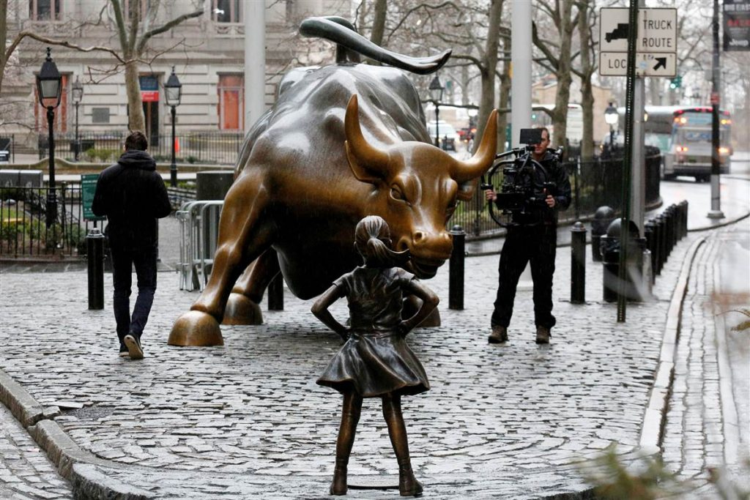
THE CULTURAL LOGIC OF NEOLIBERALISM
Contemporary culture is neoliberal capitalist culture.
Most cultural products—film, music, literature, painting, sculpture—are sold as a commodity.
neoliberal cultural industries
Neoliberalism reduces the autonomous and aesthetic value of culture to economic value.
Neoliberalism has thus gone beyond a mere economic project or political economy
Notes:
Neoliberal doctrines have been extended to cultural products, and today most cultural products—film, music, literature, painting, sculpture—are sold as a commodity, which has led toward a stifling of creativity. Contemporary culture is neoliberal capitalist culture.
The neoliberal cultural industries rhetoric meant that “culture” “has come to be seen as a magical elixir for economic growth [and] social problems as well as bringing wealth back to cities that have been in decline due to de-industrialisation” (McGuigan 2016:19), which has also been influential in post-industrial societies throughout the world.
Neoliberalism reduces the autonomous and aesthetic value of culture to economic value. A neoliberal conception of culture is thoroughly economistic. Neoliberalism “reduces art to money and distorts culture with commercial sponsorship, and philanthropic foundations take the place of a democratically accountable public sector in the endless struggle for hegemony” (McGuigan 2016:5).
Image caption:
On a December morning in 1989, New Yorkers woke to find a new fixture in their city: A bronze sculpture in the shape of a bull, installed overnight by a rogue artist.
Nearly three decades later, on March 7, New Yorkers woke to find that the iconic “Charging Bull” of lower Manhattan has company: A defiant young girl, feet planted firm with arms akimbo.
The new sculpture, by Kristen Visbal, was installed by asset management group State Street Global Advisors, in a bit of clever marketing well-timed for the March 8 celebrations of International Women’s Day. It makes for a great photo op, and sends an important message about female empowerment. But the story of how it got there epitomizes a problem that has long held women back in the workplace.
Image source and further reading: Tom McCarthy . 2017. Fearless Girl v Charging Bull: New York's biggest public art controversy in years . Available at https://www.theguardian.com/us-news/2017/apr/14/fearless-girl-statue-women-new-york-bull, accessed 21 March 2018.

Slide 9
Neoliberalism has thus gone beyond a mere economic project or political economy, since “it also entailed a battle for hearts and minds, a discursive and ideological campaign to legitimize a different set of hegemonic arrangements” (McGuigan 2016:66).
“neoliberal civilization”
neoliberalism constructs an “ideal type of a preferred neoliberal self” (27)
neoliberalism influences the very language used colloquially------“NewLiberalSpeak”
Notes:
Neoliberalism is the hegemonic ideology today (“neoliberal civilization”) currently around the whole world that shapes the sociocultural makeup of people through socialization.
Neoliberalism constructs an “ideal type of a preferred neoliberal self” (27)—successful entrepreneur, sovereign consumer, hard-working taxpayer. The neoliberal self today “is a competitive individual who is exceptionally self-reliant and rather indifferent to the fact that his or her predicament is shared with others…. Such a person must be ‘cool’ in the circumstances, selfishly resourceful and fit in order to survive under social-Darwinian conditions” (132). The neoliberal self is a new type of economic person whose thoughts, practices, and self-conceptions are shaped by neoliberalism as an economic system and organizing ideology. Socialized into a cool-capitalist presentation of self, the neoliberal(ized) individual is thereby viewed in exclusively market terms.
In the ideological battle for hearts and minds, neoliberalism influences the very language used colloquially: NewLiberalSpeak.

Slide 10
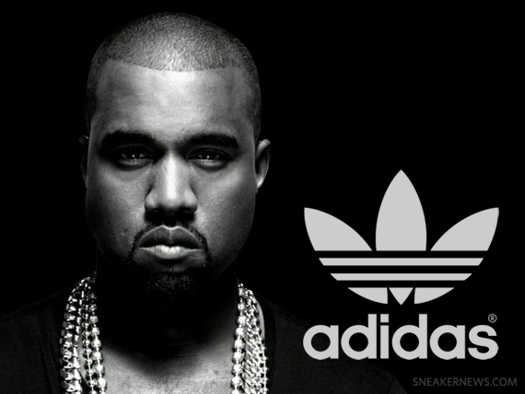
Branding
increasing cultural abstraction
a new wave of consumption based on an image industry in fashion, lifestyle, and popular culture
visible brands and branding have become ubiquitous and accepted
MTV
movies, radio, television, and the Internet act as advertisers for music, with the latter becoming possibly the most powerful advertising and marketing tool
extended to artists by the ideology of the star (“star-as-brand”)
celebrity persona pandemic”
Notes:
During the 1980s, neoliberal capitalism was shaped by the emergence of a new wave of consumption based on an image industry in fashion, lifestyle, and popular culture. It marked a new aesthetic of modern life, in which visible brands and branding have become ubiquitous and accepted. The image industry is built on advertising, a defining feature of neoliberal capitalism, and a primary symptom of today’s capitalism, in which the brand is its principal concept. MTV, owned by media giant Viacom, became established as a 24-hour commercial channel that promotes the products, lifestyle, and fashion of its owning corporation and its paying. Movies, radio, television, and the Internet act as advertisers for music, with the latter becoming possibly the most powerful advertising and marketing tool. In this hyper-commercialized market, fashion and lifestyle choices are marketed over genuine needs.
Branding has also been extended to artists by the ideology of the star (“star-as-brand”). This “celebrity persona pandemic” (Marshall 2016) has grown out the increasing fetishization of the constructed public persona in contemporary culture. Branded celebrities have become our most visible human brands. Online culture in particular, including MySpace and Facebook, has been instrumental for an increasingly greater focus on the production of the self Online culture pushes people to construct a public image. Celebrities-as-brands elevate a kind of possessive individualism and represents very directly the normalization and naturalization of the current obsession with the production of the public self—or self-branding, which has intrinsic dimensions with a focus on self-improvement through cosmetic surgery, fitness, and extrinsic dimensions with a focus on the outwardly, public presentation of the self, for instance through “technologies of the social” (television, Facebook, Twitter, and so forth).
Image credit: Kanye West x adidas Partnership Officially Announced. Available at https://sneakernews.com/2013/12/03/kanye-west-x-adidas-partnership-officially-announced/, accessed 21 March 2018.

Slide 11
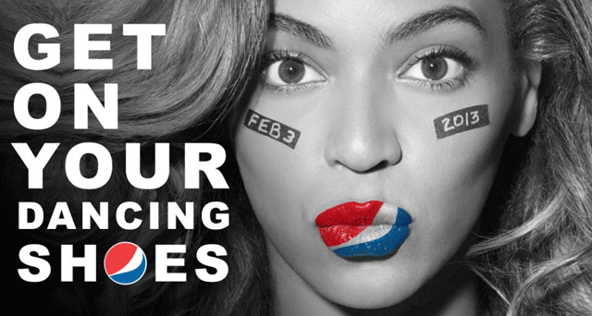
“the politics of recognition”
persona formation
a consumer culture, in which the consumption of signs penetrates all spheres of life, famously termed “hyper-commodification” (Crook et al. 1992) and “simulacra” (Baudrillard 1983).
“Our urban spaces are saturated with advertisements, not just on billboards but on our bodies and in our dreams. Every crack is filled with slogans, every piece of available space is occupied like enemy territory. Likewise, time is also saturated, very second filled with jingles and naked bodies, and more slogans – even slogans imploring us to stop looking at slogans.” (Cazdyn and Szeman 2011:58)
postmodernism
Notes:
The current era is marked by “the politics of recognition” (Marshall 2016:40). Central to contemporary experience is persona formation. Personas are complex projection and masks—fabricated and strategic presentations of the self—in a consumer culture, in which the consumption of signs penetrates all spheres of life.
This is a new era that marks a qualitative change in human experience. It is the era of postmodernism, which (to some critics) is no more than a meaningless consumer culture according to old, exploitative ways of capitalism. Postmodernism as “the cultural logic of late capitalism” (Jameson 1991) and the end of “grand narratives” and universal categorization.
Consequently, neoliberal forms of global capitalism have gradually replaced Europe’s “high” culture with a new aesthetic based on an image industry in fashion, lifestyle, and popular culture. Today’s cultural capital confers “knowledge of the hip and the cool, the trendy [which] are becoming increasingly common around the world” (Taylor 2014:195).
Image credit: https://globalnews.ca/tag/fast-food-ads/, accessed 21 March 2018

Slide 12
The Global Music Industry
Notes:
The turn toward neoliberalism has meant intensified musical commodification and cultural homogenization, alongside intense globalizing tendencies.

Slide 13
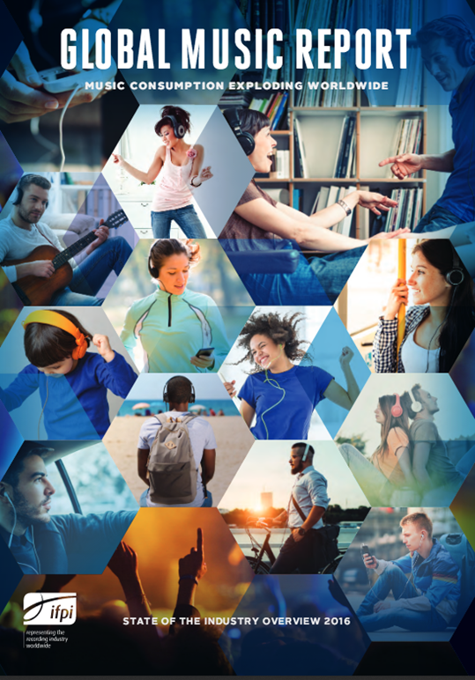
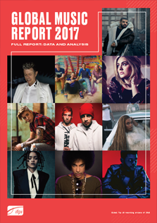
The global music industry
the US-based music recording industry evolved into global business powerhouses, facilitated by continuous vertical and horizontal mergers and consolidations
The structure and workings of the US-based music recording industry became replicated in the local music industries of countries around the world
The most concentrated global media market
Notes:
Given the huge appeal of rock music in the 1960s, the US-based music recording industry evolved into global business powerhouses, facilitated by continuous vertical and horizontal mergers and consolidations, connecting companies up and down the production-consumption chain (vertically), and aligning recording technologies with related entertainment and publication media (horizontally).
The structure and workings of the US-based music recording industry and its production values, organizational structures, and managerial practices with the manufacturing, production, and marketing of western pop and rock became replicated in the local music industries of countries around the world.
Since the 1970s, the international music industries became similarly marked by the standardization of production patterns and the pop-rock aesthetic. This meant that local music industries either mimicked major music corporations, or implemented professional conventions and complied with norms by the majors with whom they collaborated.
The music industry has become the most concentrated global media market. Currently there are only three large music corporations (The Big Three): Universal Music Group (US-based; part of French media giant Vivendi); Sony Music Entertainment (part of media giant Sony, both US and Japan; includes BMG, part of German Bertelsman); and Warner Music Group (US-based; separated from Time Warner in 2004).
The music recording industry is situated in the most developed countries (US, UK, Japan, Germany, France) that dominate the music market, representing around 75 – 80 percent of the total global market share (IFPI’05 2005).
Image credit: http://www.ifpi.org/recording-industry-in-numbers.php, accessed 21 March 2018.

Slide 14
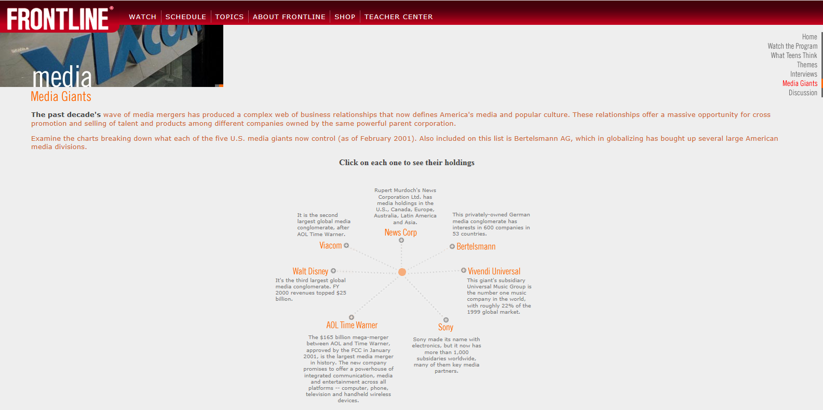
Structure:
two of the Big Three (Universal Music and Sony Music) are subsidiaries of larger media conglomerates
Warner Music Group is independent, but similarly a conglomerate corporation.
The large media corporations that have absorbed music record corporations
horizontal and vertical mergers
Notes:
The structure of the media conglomerates, to which Universal and Sony belong, is thus underpinned by acquisitions of sub-companies, as well as mergers across larger corporations (horizontal integration).
In the noughties, there exist six giant media corporations (GE, News-Corp, Disney, Viacom, Time Warner, and CBS) that control 90% of media outputs. The large media corporations that have absorbed music record corporations operate “in a variety of fields beyond recorded music, incorporating publishing, television, electronics, and telecommunications, thus extending their influence to cover more markets within the global entertainment industry” (Frontline 2014).
Through vertical mergers, meanwhile, corporations can connect smaller companies further up and down the production/consumption chain, such as for music touring and retail. Both horizontal and vertical mergers enable corporations to create synergy with related entertainment industries by successfully aligning recording technologies with the dissemination capacities of other entertainment media, including radio, cinema, television, and the Internet. Big corporations continuously buy up smaller companies to help sell products across markets, so that business is fed to companies within the same corporation.
Optional further study/screenshot credit: Media Giants. Available at https://www.pbs.org/wgbh/pages/frontline/shows/cool/giants/, accessed 21 March 2018.
About the structure of media corporations, see here:
http://www.pbs.org/wgbh/pages/frontline/shows/cool/giants/
and about music corporations here:
http://www.pbs.org/wgbh/pages/frontline/shows/music/inside/giants.html

Slide 15
The effects of synergy
Cross-media marketing
the artist is plugged into other entertainment media to create synergy between his/her song(s) and a movie, TV show, product (car, perfume, makeup), game, magazine, musical, or another outlet
celebrities’ value moves across different fields, who are “used—and paid—to create events, sell magazines, and construct our world of entertainment value” (Marshall 2016:80).
Examples:
Mamma Mia! (Universal Pictures)
Pop Stars
Notes:
Through cross-marketing, celebrities’ value moves across different fields, who are “used—and paid—to create events, sell magazines, and construct our world of entertainment value” (Marshall 2016:80).
Synergy can happen within one large corporation, as well as across large corporations, whereby artists and their music are plugged in such a way that it becomes beneficial to all companies involved.
Examples: Mamma Mia and Pop Stars; see Documentary Money for Nothing: Behind the Business of Pop Music]

Slide 16
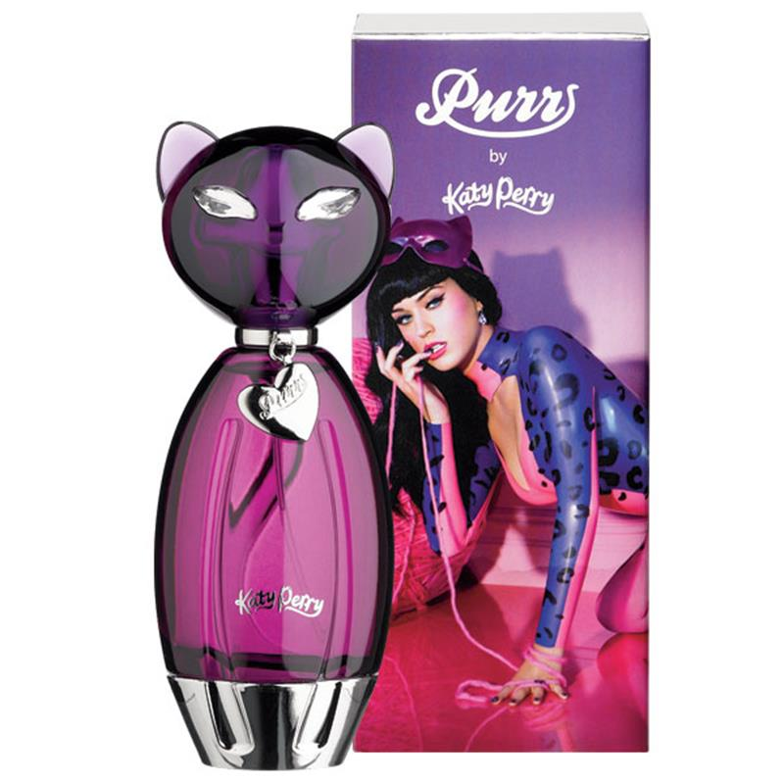
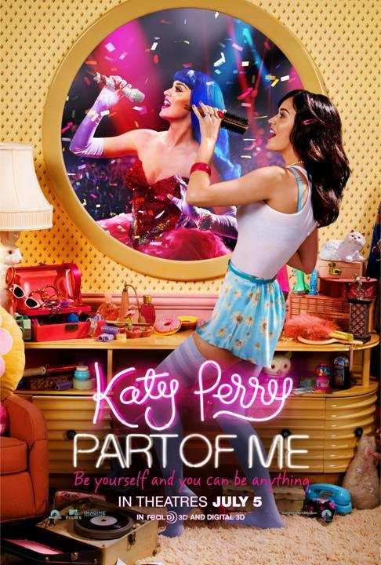
Notes:
Another successful example of cross-media marketing is demonstrated by the innovative artist Katy Perry. She released four “top five” albums while signed to Capitol records, which in turn helped to build a successful brand reaching into music, retail, television, film, and gaming.
For instance, Katy Perry released three perfumes called Purr, Meow, and Killer Queen, the latter of which being accompanied by a one-minute long advertisement, which also debuted on national television (Hollywood Life 2013). Meanwhile, the film industry used brand “Katy Perry” in 2012 when she released her debut film Part of Me in 3D based on her Teenage Dream tour, and in the gaming industry she released her own extension pack as part of the popular gaming range called The Sims 3: Sweet Treats (EA Games 2012). Synergy is thus clearly apparent within Perry’s musical work: the artist is signed by Capitol Records, which is owned by Universal Music Group; her perfumes are manufactured and promoted by Coty Beauty (Billboard 2012); Part of Me in 3D was produced by MTV films, which is owned by Viacom, so her music videos and songs are frequently played on MTV channels (Frontline 2014); lastly, her personalized video game was created by Electronic Arts, a gaming company notorious for being the third successful gaming company in the world (Software Top 100 2010).
Image credits: xxx

Slide 17
Imprint label buy-up and ownership
Warner Music Group: Elektra, Atlantic, Rhino, Kinetic, Maverick, and Warner Brothers records
Universal Music Group; Def Jam, Island and MCA Records, Hemisphere, Parlophone, Capitol, and Virgin records
Sony: Columbia and Epic label group
Even though independent labels contribute toward increased diversification and satisfy local niche markets, it is ultimately the Big Three who hold near-total control over musical production and consumption, as their complex production, distribution, and promotional networks make it difficult for alternative, independent companies to succeed.
Notes:
Further down the record music corporations are the imprint record labels. As corporations have become increasingly concentrated, they own growing portfolios of record labels in different territories globally. They also own many well-known smaller labels, which, while often started by entrepreneurs, have been absorbed into the corporations, specifically when the signed artists promise high degrees of corporate success (e.g. Island Records).
* An example is the buy-up of independent labels like Tommy Boy (bought out 50% by Warner Brothers) and Def Jam (bought by Columbia Records), who began releasing grassroots, street-level hip hop from the south Bronx.
* The band The Coral, a Scouse-centric band that signed with Deltasonic Records who dominate the Liverpool niche market, gained more national blanket success through internationalized distribution channels via Universal Music Group.
* The Seattle-centric band Nirvana, who first achieved niche success with the independent Sub-Pop Records, were bought up by Geffen Records (a subsidiary of MCA) and later absorbed into Universal Music Group.
The majors are able to monitor independent labels who engage in innovative practices, while avoiding the risks involved in signing artists before they have reached some popularity and at the same time, independent and smaller record labels are often easily influenced by corporate capitalist thinking. Small labels will continue to exist, yet their growth may be hampered without becoming part of one of the major corporations, and this has two effects: on the one hand, the absorption of independent labels means the distribution of increasingly wide-ranging repertoires in different geographical markets and musical genres, marked by increasing musical hybridization and diversification. Yet it is ultimately the Big Three who hold near-total control over musical production and consumption, as their complex production, distribution, and promotional networks make it difficult for alternative, independent companies to succeed.

Slide 18
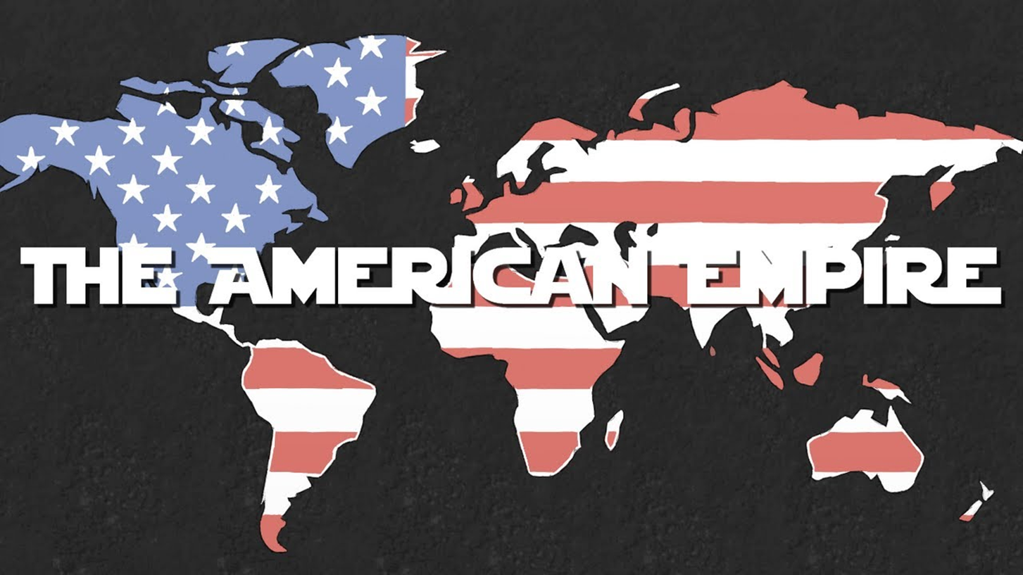
CULTURAL IMPERIALISM
cultural homogenization
Antonio Gramsci’s notion of “cultural hegemony”
a more insidious pervasion of “discourse” (“discursive formation” (Foucault 1970)), via the mass media and large-scale institutions
Theodor Adorno’s “culture industry”
Notes:
During the mid-1970sglobalization became conceptualized by the dominant theory of cultural imperialism. It was believed that cultural globalization leads to cultural homogenization (Tomlinson 1991, 1999:71-105).
The impetus for this image came partially from the Italian theorist Antonio Gramsci and his notion of “cultural hegemony”, suggesting more insidious pervasion of “discourse” via the mass media and large-scale institutions. Globalization, it was believed, consequently leads to the demise of local culture, which becomes overwhelmed by the symbols and icons of western (popular) culture.
The conceptual foundations were laid by cultural theorist Theodor Adorno (1903-69) in his critiques of the capitalist-driven “culture industry”.
Cultural imperialism suggests that economic globalization is eroding local, indigenous culture and traditions, which become replaced by the icons of western, and particularly American, popular culture. Cultural imperialism is seen by many critics as a form of Western neo-colonialist domination, one based on symbolic and psychological means of control. Artistic expression becomes a standardized commodity.

Slide 19
Rammstein’s “Amerika” (2004)
Notes:
This criticism was taken up by the rock band Rammstein when conceiving their song “Amerika” from their album Reise Reise (2004). The band adopts a cynical standpoint toward globalization. For instance, the lyrics and video make reference to various globally commodified goods of popular culture, including Mickey Mouse, Lucky Strike cigarettes, Nike trainers, Santa Claus, Coca Cola, wonderbra, pizza, television, and Santa Clause.
The critique of the image of Santa Claus is noteworthy here. In the context of Christmas culture, the image of Santa Claus can be read as the “God of Materialism”, for he is a figure to which American society has had its deepest values ingrained into (Hirschman and LaBarbera 1989). The example of the commodification of Christmas culture highlights the worrying aspect of globalization, namely the standardization of beliefs and the ways in which these beliefs are dressed up in a traditional manner, since they themselves have now become a tradition.
“Cultural imperialism” hence refers to the hegemonic cultural, economic, and political role of the United States. We thus often find terms like Americanization, Westernization, and McDonaldization (Ritzer 2011) in discussions of cultural imperialism.
Audio-visual study: Music video of Rammstein’s ‘Amerika’, available at https://youtu.be/Rr8ljRgcJNM, accessed 21 March 2018.

Slide 20
Katy Perry’s “Chained to the Rhythm” (2017)
Notes:
In January 2017, Katy Perry delivered a more contemporary critical “take” on Americanized culture in a track from her fourth album.
Audio-visual study: Music video of Katy Perry’s ‘Chained to the Rhythm’, available at https://youtu.be/Um7pMggPnug, accessed 21 March 2018.

Slide 21
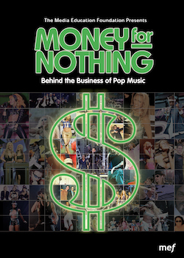
Money for nothing: behind the business of pop music
I. Focus on the Business aspect of the music industry
II. 5 conglomerates control 80%
BMG, Sony, AOL Time Warner, Vivendi, EMI
III. Independents=eaten up by BIG 5
ex. Springsteen
IV. Talent vs. Sensation
V. Accountants control music industry/know little about music
ex. Thriller
VI. No incentive for companies to offer variety
ex. Dion
VII. Mega-artists=strong financial position
Mid-range artists=precarious fin. pos.
ex. Aimee Mann; sell 800,000 before breaking even
VIII. Growing support for Musicians Union
ex. TLC
IX. The Gatekeepers
Radio, MTV, Touring, Retail
X. Music Advertising & Marketing
Cross-media marketing/SYNERGY; ex. BeeGees, Stars, Mandy Moore
Having songs in Ads, ex. Moby, Nick Drake
XI. Independent alternatives
ex. Righteous Babe, Dischord, “Indies”
Notes:
Audio-visual study: MONEY FOR NOTHING: Behind the Business of Pop Music (46 mins)
I. Focus on the Business aspect of the music industry
II. 5 conglomerates control 80%: BMG, Sony, AOL Time Warner, Vivendi, EMI
III. Independents=eaten up by BIG 5
ex. Springsteen
IV. Talent vs. Sensation
V. Accountants control music industry/know little about music
ex. Thriller
VI No incentive for companies to offer variety
ex. Dion
VII. Mega-artists=strong financial position
Mid-range artists=precarious fin. pos.
ex. Aimee Mann
Sell 800,000 before breaking even
VIII. Growing support for Musicians Union
ex. TLC
IX. The Gatekeepers
A. Radio
B. MTV
C. Touring
D. Retail
X. Music Advertising & Marketing
A. Cross-media marketing/SYNERGY
ex. BeeGees
ex. Pop Stars
ex. Mandy Moore
B. Having songs in Ads
ex. Moby
ex. Nick Drake
XI. Independent alternatives
ex. Righteous Babe
ex. Dischord
ex. “Inties”

Slide 22
Musical homogenization
by the 1980s and 1990s, the varying cycles of increased or decreased musical diversity exist under the auspices of the major transnational music corporations (Regev 2013:80).
“big” names who promise “safe” profits: Michael Jackson, Rihanna, Drake, Madonna, Mariah Carey, Jackson, The Beatles
Meanwhile further afield: In China, Hong Kong pop star G.E.M. is hailed as the “China's Taylor Swift”; New Zealand-born Parris Goebel; Singaporean singer-songwriter Joel Tan, aka Gentle Bones, has been described as Singapore’s Ed Sheeran.
Notes:
The theory of cultural imperialism has been conceptualized in popular music discourses by analysing the structure and workings of the global music industry as part of the larger cultural industries.
These have enormous control over what kind of music gets produced, and are the reason why some musicians become huge stars and are heard by millions, while others do not. Since the large corporations are tied up financially in the global stock market, the emphasis of their activity nowadays is on financial stability and quick sales. In doing so, they seek to avoid risks that can arise from musical innovation and development, and instead often focus on selling sensation and spectacle, fashion, and lifestyle surrounding a few “big” artists. Stars like Rihanna, Drake, Madonna, Mariah Carey, Jackson, The Beatles, and others mean “safe” profits, and to the music corporations, there is little incentive to diversify their roster.
This same trend is also noticeable in other parts of the world. In China, for instance, Hong Kong pop star G.E.M. is hailed as the “China's Taylor Swift” with millions of fans across China. Singing in Mandarin and writing songs about love, G.E.M. has been compared to one of the world's biggest pop stars (Liu 2017). Meanwhile, New Zealand-born Parris Goebel has become established as a global dance and style icon, while Singaporean singer-songwriter Joel Tan, aka Gentle Bones, has been described as Singapore’s Ed Sheeran.
Image credit: Jackie Chan. 2016. G.E.M. beats Jackie Chan and Donnie Yen to be named most popular star on Hong Kong social media . Available at http://www.scmp.com/lifestyle/music/article/1922397/gem-beats-jackie-chan-and-donnie-yen-be-named-most-popular-star-hong, accessed 21 March 2018.

Slide 23
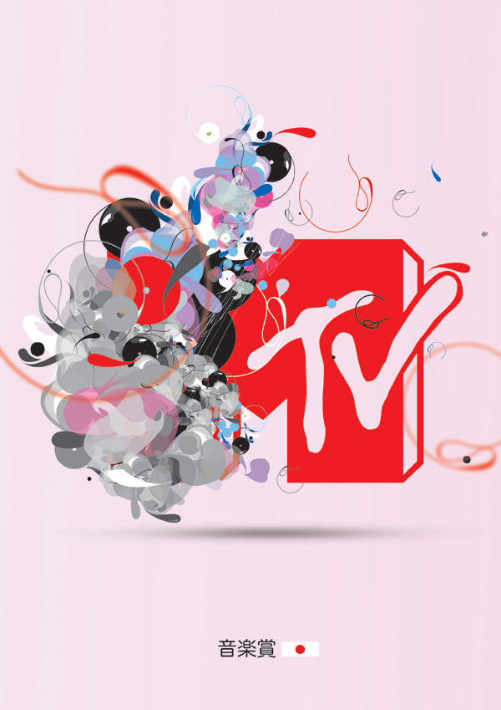
Control over promotion of artists and their music
streamlining and standardizing of playlists for carefully selected profitable artists
MTV…
a centralized national marketing system controlled by advertising. MTV, now a global channel that reaches over 320 million households in ninety countries on five continents, twenty-four hours a day is vital to the marketing of music. And again, the major record labels have extremely close links with MTV. (Thurston Moore; in Jhally and McLeod 2005:9)
Notes:
It is also the subsequent promotion of artists and their music that is influenced and controlled by the centralized music industry.
The Big Three corporations connect smaller companies further up and down the production/consumption chain, such as for music touring and retail, while through horizontal mergers, they aim to create synergy with related entertainment industries, including radio and television.
The near-monopoly situation in the US has resulted in streamlining and standardizing of playlists for carefully selected profitable artists, a working practice that has spread around the world.
Meanwhile, MTV, owned by media giant Viacom, is a 24-hour commercial channel created to promote the products, lifestyle, and fashion of its owning corporation and it’s paying advertisers. To this end, MTV is an infomercial that sells music for a label or clothing product, fashion and lifestyle, markers of the post-Fordist capitalist culture industries. And it is specifically the sexist, misogynistic imagery in pop music video that “sells”, a critical issue to be explored later on in the chapter.

Slide 24
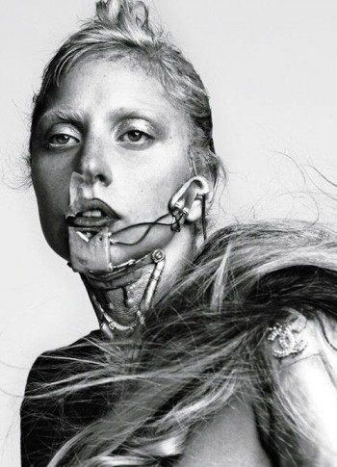
Control over touring and retail
A further driver of musical homogenisation is the fact that movies, radio, television, and the Internet act as advertisers for music:
Michael Jackson’s “Billy Jean” for a Pepsi commercial;
The Beatles’ “Revolution” used for a Nike advert
Ray Charles’ “You got the right one, baby!” for a Diet Pepsi advert
Nick Drake’s “Pink Moon” used in a Volkswagen Cabriolet commercial
marketing and promotion are the biggest expense in introducing a musician to the public.
marketing efforts have shifted substantially online
A major international signing costs between $500,000 and $2 million to break in a major market, of which between US$200,000 – 700,000 is spent for marketing and promotion.
For example, “with Justin Bieber’s album, Purpose, his record company harnessed its global reach in coordination with local teams around the world. In total around 1,500 marketing experts were involved in launching it to his fans, helping to make it a huge global success” (IFPI 2016:12).
Notes:
The power of the Big Three goes further into touring. Large venues are often owned by promotion companies that are in turn owned by one of the large record labels, which in turn exercise enormous control over which artists play in these venues. Retail was another important gatekeeper for the record companies to reach their customers, through which musical homogenization is reinforced and perpetuated.
A further driver of musical standardization is the fact that movies, radio, television, and the Internet act as advertisers for music. TV commercials for products like cars, perfume, and clothing are frequently used to sell music records and break new acts for the major record labels.
The celebrity, larger-than-life figure, is admired and celebrated and, at times, event emulated. For instance, the phenomenon of teen pop that emerged in the late 1980s reflects this to a certain extent, as there are concrete similarities between the various acts, such as Britney Spears, Kylie Minogue, Christina Aguilera, or Justin Timberlake.
The power of advertising and branding is so great that it can break new acts or inject new life into old ones, while exposing them to a whole new audience. This is a consumer culture, in which artists are valued for their potential tie-ins across the entire creative industries.
To which the IFPI recently adds that marketing and promotion are the biggest expense in introducing a musician to the public. As consumers increasingly access music digitally, marketing efforts have shifted substantially online.
Image credit: Lady Gaga. In Mind Control in the Music Industry. Available at https://taicarmen.wordpress.com/2012/02/22/mind-control-in-the-music-industry-part-1/, accessed 21 March 2018

Slide 25
“The production of a mass cultural form like popular music is similar to the production of any mass produced product, such as an automobile or a bar of soap. Recordings generally sound the same with some variation due to the handicraft nature of music production, because record companies seek to maximise profits by limiting the cost of production, and the risks involved in innovation. Artistic expression and cultural significance have no place within the assembly line.” (Fenster and Swiss 1999:235)
Notes:
The capitalist market structure that underpins the workings of the Big Three thus favors few, but safe artists, as they can guarantee financial security to underwrite the huge costs afforded for promotion and advertising. Accordingly, musical diversity is said to be under threat, as the corporate workings of the music industry homogenizes music. Music begins to sound and feel the same the world around.
Musicians thus often face a critical dilemma: while many are drawn to music to do something special, they quickly realize that they are merely one of many commodities that the corporation is trying to pitch. It forces musicians to orient themselves toward the interests of wealthy, revenue-providing markets, and to pitch their music and image according to (mostly) European and North American musical tastes. Musicians often comply in their desperate desire to secure a record deal with one of the majors. In other words, musicians willingly self-censor their music and image, as the music industry has the power to decide what to release, usually with an imagined market in mind.

Slide 26
Part ii: the other in popular music in neoliberalism
Notes:
The 1980s also marked a shift toward a global preoccupation with “image” (notably on Music Television) and the sexualized female form that serves to objectify women. Concepts in feminist media analyses like the “male gaze” and “controlling images” became powerful tools for analyzing and critiquing traditional white supremacist patriarchy, including the representation of black women and femininities. In considering the politics of othering in neoliberal culture, it is equally critical to highlight that the remnants of racist identity constructions still reverberated throughout this phase. While obvious racist stereotypes in mediated representations became rare, more subtle and hidden racialized narratives continued to be expressed in popular music.

Slide 27
Music television and the male gaze
Within the modern music industry, inequalities between women and men have become less overt than, for instance, during the nineteenth century. Yet the deregulation of broadcasting by market force governments and the development of cable and satellite services have resulted in the introduction of 24-hour music channels (e.g. MTV), which has seen a shift in the subordination suffered by women and a preoccupation with “image” and the sexualized female form that serves to objectify women.
Notes:
Gender, specifically, became a marketing variable that reproduced socially constructed gender ideologies.
Rock music became useful to MTV’s goal of “elevating white-male musicianship and creating an idealized vision of white-male spectatorship” (Lewis 1990:32), while oppressing female musicians and their audiences who were devalued as artists by relegating their music to pop music categories.
Pop images became crucial mass-marketing tools, creating desire for “slick sexual presentation”. And it is usually the female artists and women in pop videos who are overtly sexualized and subjected to the “male gaze”, which in turn normalizes patriarchal ideologies that place women as sex objects in a position of male subordination.

Slide 28
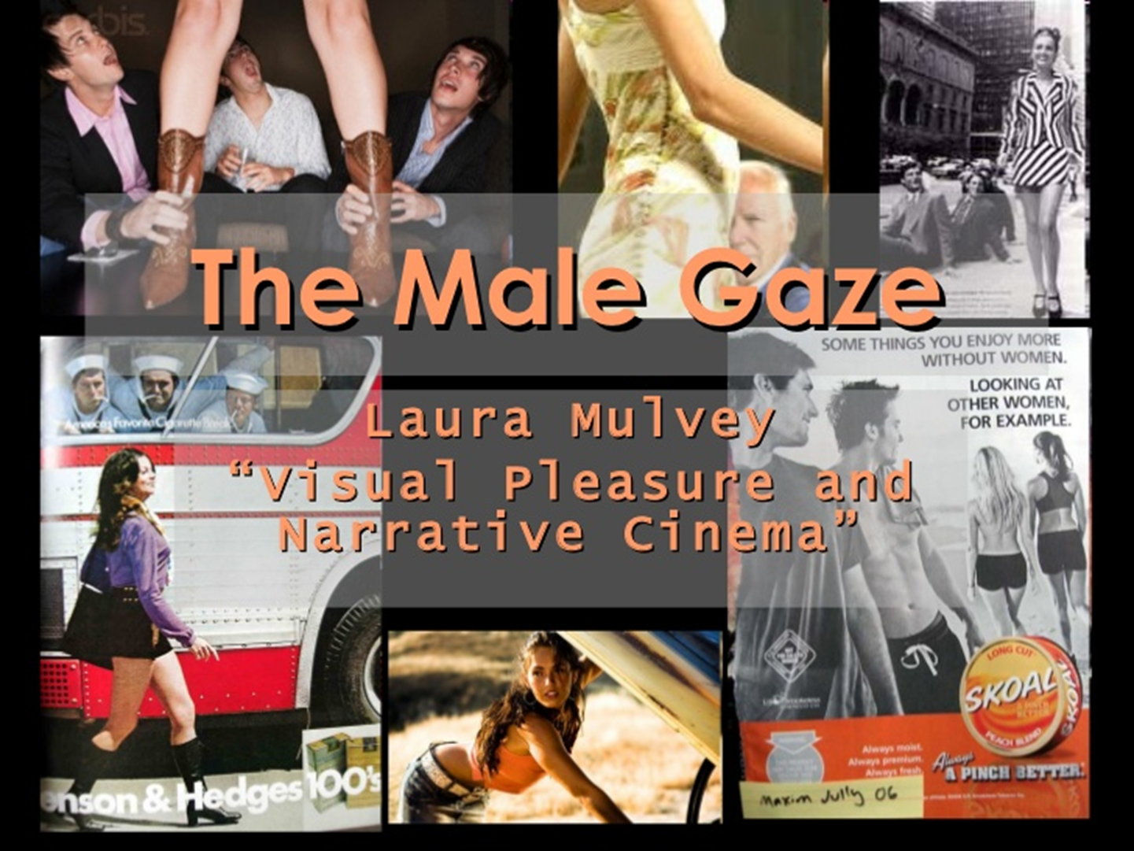
Laura Mulvey (1975): the “male gaze” to understand media constructions of woman as spectacle, the gender of the gaze, and voyeuristic pleasure.
the patriarchal definition of “looking as a male activity” and “being looked at as a female ‘passivity’” - “women as objects of the male gaze”
Notes:
Optional audio-visual study/image credit: https://www.slideshare.net/fleckneymike/the-male-gaze-laura-mulvey

Slide 29
“In western society, to be looked at is the fate of women, while the act of looking is reserved to men… Men act and women appear. Men look at women. Women watch themselves being looked at. This determines not only most relations between men and women but also the relation of women to themselves. The surveyor of woman in herself is male: the surveyed female. Thus she turns herself into an object – and most particularly an object of vision: a sight.” (Van Zoonen 1994:88)
Indeed, “to be accepted in the mainstream of the culture, female artists find that they must embrace the vision of the pornographic imagination and enact the fantasies of male video producers and viewers” (Yousman et. al. 2007:18).
Notes:
This “to-be-looked-at-ness” has the effect that the culture industries prescribe women to be beautiful and slender, a pleasure to be looked at. Across many popular music genres today, the emphasis is directed at women’s image: how they look and how they dress, and this relates directly to patriarchy in music culture: “Women are mere beauties in men’s culture so that culture can be kept male” (Wolf 1991:59).
Many female artists have had to adopt visual conventions used in music videos by male artists in order to gain success in the music industry (Jhally et al. 2001). They seductively perform for the camera, touch and undress themselves, with the camera roaming their bodies and zooming in on disconnected body parts.
Artists like Madonna, Gwen Stefani, Lady Gaga, and Beyoncé, who actively seek to convey a powerful, independent persona, have used their sexuality in order to express power in music video. Other artists’ images like Janet Jackson, Jewel, Britney Spears, Mariah Carey, Jessica Simpson, and Christina Aguilera have changed gradually from a more innocent adolescent feminine image to one defined by conventional sexualized and hyper-sexualized imagery.

Slide 30
Dreamworlds: whose dream, and whose worlds?
Notes:
Optional audio-visual study: Dreamworlds 3: Desire, Sex and Power in Music Video
The documentary is divided into the following sections:
Introduction
Techniques of storytelling
Constructing Femininity
The pornographic imagination
Ways of looking
Female artists: trapped in the pornographic gaze
Masculinity and control
Further reading: Discussion guide and transcript accompanying Dreamworlds 3, available at https://shop.mediaed.org/dreamworlds-3-p86.aspx
Discussion questions:
What is the impact of sexual imagery in music videos on young people?
Do you think that gendered representations in music videos can impact on criminal behaviour?
Is there a direct relationship? Are there other factors that may cause criminal behaviour?
Do you think there might be a link between MTV and sexual abuse?

Slide 31
Speak out!
BBC. 2016. “Singer Bjork Denounces Sexism in Pop Music Industry”. BBC, 22 December 2016
The Guardian. 2016. “Björk on Sexism: ‘Women in Music are allowed to Sing About Their Boyfriends’”. The Guardian, 21 December 2016.
Turner, Camilla. 2015. “Sexism is Worse in the Music Industry Now Than It Was in the 1960s, Says Lulu". The Telegraph, 1 March 2015.
Siddiqi, Ayesha A. n.d. “Lily Allen’s Anti-Black Feminism”. Noisey.
Johnston, Maura. 2016. “Sexism on Repeat: How the Music Industry Can Break The Cycle”. The Guardian, 22 March 2016.
Etc…
Notes:
These news media articles are listed in the case study examples and may be used as prompts for further discussion. Students may also be encouraged to add more current articles from the popular media that address the issue of sexism in the music industry.

Slide 32
Arabpop
The Arab music world is sharply divided between music of the “golden age” (1930s-70s) and the Arabpop phenomenon that has emerged since the 1980s. Although originally incorporating influences from European music, the music recorded by the likes of Umm Kulthum, Mohammed Abd-Wahab… [etc.] came to signify high art and Arab uniqueness. When, in the 1990s, Arabpop singers started to record songs by these canonic artists in electronic, danceable arrangements, it evoked some enraged responses. (Regev 2013:53)
Notes:
The sexualization of the female body through mediated representations is also present in popular music from other parts of the world. In recent years, Arabpop has become increasingly under fire for overt sexualisation of female artists.

Slide 33
Notes:
Optional audio-visual study: [embedded YouTube videos]
Haifa Wehbe ‘Ragab’, available at https://youtu.be/WMcD8wkOONQ
Ruby ‘Enta Aref Leih’, available at https://youtu.be/--oTv4bfp7I

Slide 34
RACISM(S) in popular music in neoliberalism
Race is still an important means for certain social groups to classify their own and other people’s identity.
Obvious racist stereotypes in mediated representations are rare today, but there still exists a kind of racism that is more subtle and hidden.
Some contemporary representations of race continue to associate black people, specifically young men, with crime, violence, drugs, gangs, and teenage pregnancy, which is most evident in hip hop and rap.
Stereotypes in mediated representations in much commercialized Hip Hop continues to epitomize a “white” view of the world (Jhally et. al. 2003, 2005).
Notes:
In neoliberal culture, racialized narratives continue to be expressed through and experienced in popular music, and the remnants of racist identity constructions still reverberate today with persisting racism and economic disadvantage in the UK, US, and elsewhere. Much contemporary popular culture continues to be shaped by a pervasive race consciousness, hegemonic ideals of white supremacy and racism.
Classifications serve the politics of othering on the basis of race, which is highly political. Racist and populist music reveals some of the most stereotyped conventions of racism. Critical conceptualizations of racialization thereby allows us to problematize the power produced by racialization.
Hip Hop, like other forms of African-American culture, emerged in the “ghettos” of US-America. “Black music” has assumed a sense of “blackness” as an important marker of shared racialized identity. It is the reason why bold generalizations about Blacks pertain. Stereotypes in Hip Hop have served dominant groups to maintain power over subordinate groups, while this power over mediated representations—the right, ability, and access to the media to make representations—has historically been upheld by white people (CEOs, executive directors of powerful media conglomerates). Mediated representations in much commercialized Hip Hop continues to epitomize a “white” view of the world (Jhally et. al. 2003, 2005).
Footnote: Until recently in the United States, blackness was integral to the legal systems of different states to legitimise slavery and racial subordination. Under the Jim Crows law, what constituted a “black” person varied between different states: in Alabama, Arkansas and Mississippi, anyone with a ‘visible’ and/or ‘appreciable’ degree of ‘Negro blood’ was a “black” person; in Indiana and Louisiana the colour line was drawn at one-eighth and one-sixteenth negro blood (after Longhurst 1995:128).
Optional audio-visual study:
Track 4 in Dreamworlds 3: Desire, Sex and Power in Music Video
35 mins ff. in Tough Guise: Violence, Media, and the Crisis in Masculinity

Slide 35
2017 Grammy Awards in Los Angeles
Hann, Michael. 2017. “From Aretha to Beyoncé: The Black Artists Snubbed By The Grammys”. The Guardian, 16 February 2017.
Artists themselves have spoken out about the pervasive racism in the music industry:
NME News Desk. 2015. “Rihanna on Racism in the Music Industry: ‘It Never Ends’”. NME, 12 October 2015.
July, Miranda. 2015. “A Very Revealing Conversation With Rihanna”. The New York Times, 12 October 2015.
Notes:
Subtler forms of racism lingering in much contemporary popular culture became a focus of attention at the 2017 Grammy Awards in Los Angeles, which caused furore surrounding Adele’s victory over Beyoncé for the album of the year award, the top prize at the Grammy Awards. Adele herself appeared unconvinced during her acceptance speech, saying “I can’t possibly accept this award” and addressing Beyoncé directly: “You are our light. And the way that you make me and my friends feel, the way you make my black friends feel, is empowering!” She then snapped her Grammy in two to share it with Beyoncé.
The issue is around the huge commercial success and creativity of R&B and Hip Hop, yet the album of the year prize at the Grammys has usually been awarded to white artists, with only few exceptions. Black artists like Beyoncé, Kendrick Lamar, Frank Ocean, the Weeknd, Pharrell Williams, Kanye West, and Drake have been shortlisted in the past few years, but have lost out. Many of these artists are not marginal who have been overtaken by more mainstream artists, but many of them are the main drivers of contemporary popular culture: “They are hit artists, the most-talked about artists of the moment.” (Hann 2017:2)
Artists themselves have spoken out about the pervasive racism in the music industry. In 2015, Rihanna revealed that despite her huge success her “race” frequently plays a role in her business dealings, and she criticized the ongoing racial profiling and racist assumptions people make based on her skin colour (NME News Desk 2015). In an interview, she said: “I have to bear in mind that people are judging you because you’re packaged a certain way – they’ve been programmed to think a black man in a hoodie means grab your purse a little tighter. For me, it comes down too smaller issues, scenarios in which people can assume something of me without knowing me, just by my packaging.” (July 2015)
Optional case study examples: these are listed in the case study resources and may be used for further reading and discussion:
Hann, Michael. 2017. “From Aretha to Beyoncé: The Black Artists Snubbed By The Grammys”. The Guardian, 16 February 2017. Available at https://www.theguardian.com/music/2017/feb/16/from-aretha-to-beyonce-the-black-artists-snubbed-by-the-grammys
NME News Desk. 2015. “Rihanna on Racism in the Music Industry: ‘It Never Ends’”. NME, 12 October 2015. Available at http://www.nme.com/news/music/rihanna-64-1209853
July, Miranda. 2015. “A Very Revealing Conversation With Rihanna”. The New York Times, 12 October 2015. Available at https://www.nytimes.com/2015/10/12/t-magazine/rihanna-miranda-july-interview.html?smid=tw-tmagazine&smtyp=cur&referer&_r=1 n

Slide 36
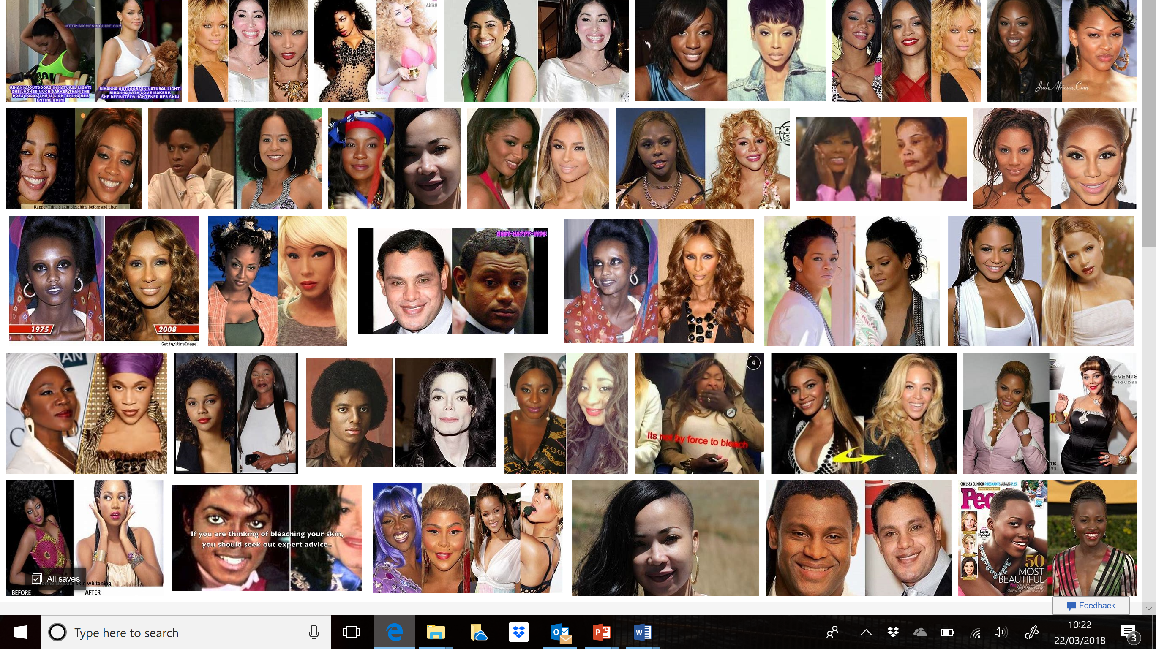
Skin bleaching/lightening/toning is a transracial global phenomenon, and is complexly interwoven within global capital and the profits of multinational corporations and small entrepreneurs.
Notes:
Consequently, many contemporary (predominantly female) artists actively and purposefully engage in a body politics of skin bleaching/lightening/toning, which has become part of their “celebrity persona” construction and production of the self.
The colour complex that it produces has been spread around the globe, in part through media images, and helps to sustain the multibillion-dollar skin bleaching and cosmetic surgery industries. The practice of skin transformation and shade shifting through bleaching/lightening/toning is widespread and well-established among women globally due to a global cultural preference for white/light skin and its link to white supremacy (Nakano Glenn 2008:282), which is amplified, particularly, for black women through the prevalent discourse of a desire for whiteness/lightness because of the impact of global white supremacy.
In popular music, Michael Jackson’s alteration of his racially marked features has received by far the most attention in public and scholarly discourse as an artist who “has made ample use of skin bleaching agents and heavy white pancake make-up” (Davis 2003:82).
A google search on “celebrities skin bleaching” quickly brings up a string of websites claiming celebrities like Rihanna, Beyoncé, Janet Jackson, Nicki Minaj, Eva Longoria, Jennifer Lopez, Lil’ Kim, or Sammy Sosa, while advertising the “best skin lightening products” to their readers. Indeed, celebrity endorsement of skin whitening products is a key marketing strategy for the global beauty and cosmetics industry.
Background image credit: Image webpage result for Bing search <celebrity skin bleaching> https://www.bing.com/images/search?q=celebrity%20skin%20bleaching&qs=n&form=QBIR&sp=-1&pq=celebrity%20skin%20bleaching&sc=0-24&sk=&cvid=1841996CE81541648760F3448A1682CD

Slide 37
Notes:
Cultural appropriation is another form of subtle racism in neoliberalism. Some contemporary artists like Gwen Stefani, Katy Perry, and Avril Lavigne have been heavily scorned for cultural appropriations in their music videos and appearances.
Criticisms have come in response to Perry’s music videos and live appearances, such as “This Is How We Do It”, a 1995 R&B hit song, in which Perry appropriates African-American and other racial stereotypes; or “Dark Horse” [see embedded YouTube video] where Perry plays around with stereotypes of Ancient Egypt, including the mysterious magic of the Arab world and racial divisions between white-skinned pharaoh and dark-skinned servants, and showing a man wearing a pendant with the Arabic word for “God” being burned down by a lightning strike (which caused a storm when 50000 Muslims petitioned the video to be taken down for its blasphemous content); and “Birthday” with Perry representing a “yarmulke-wearing, afro-sporting Jewish comic [Yosef Shulem] who ‘for a price’ will ‘do a funeral’” (Elan 2014b:1).
During the 2010 Coachella Music Festival, Perry wore her interpretation of Native American female attire, while in 2013 Perry opened the show at the American Music Awards with a performance of “Unconditionally” in Japanese geisha dress style, while the spectacle included a cherry blossom rain shower, taiko drummers, and a shrine for the Japanese religion of Shinto.
In the 2014 performance of “I Kissed a Girl” [see embedded YouTube video] during her Prismatic tour, Perry surrounded herself with “very curvy black women dressed as mummies…. These back-up dancers were all outfitted with exaggerated red lip paint, likely done for artistic purposes, but also bringing to mind perceptions of black people as having relatively bigger, fuller lips than Caucasians and other ethnic groups.” (Clifton 2014:9).
Optional audio-visual study [embedded YouTube videos]:
Katy Perry ‘Dark Horse’. Available at https://youtu.be/0KSOMA3QBU0
Katy Perry ‘I Kissed A Girl’. Available at https://youtu.be/WR3dBmGEUi4

Slide 38
Notes:
Another much criticized form of subtle racism is the appropriation of the bindi, an ancient religious adornment, as a quirky sign of otherness by famous celebrities like Björk, Siouxsie and the Banshees, Vanessa Hudgens, Sarah Hyland, Selena Gomez, Gwen Stefani, Iggy Azalea, Katy Perry, and Azealia Banks (Elan 2014a).
Critics of such cultural appropriations argue that “capitalism makes it easy to take something that is spiritually and culturally significant to a group of people and make it available for widespread production because ‘it’s pretty’ and it will ‘sell well’… So many pop stars are accessorizing themselves with… our own culture…. For them, it’s cool.” (Berumen n.d.).
Meanwhile, music festivals have started to address the issue of cultural appropriation by banning headdresses simulating the sacred creations of Native American spiritual leaders and tribespeople. For instance, the 2014 Bass Coast electronic music festival in British Columbia (Canada) or the 2015 Montreal Osheaga Music and Arts Festival did not permit festival-goers to wear the Native American feathered headdresses in a public effort to respect the dignity of the aboriginal people (Lynskey 2014; Marsh 2015).
Cultural appropriations in contemporary popular music are not new at all, and much popular music has been similarly littered with exoticized symbolisms that evoke the faraway since the beginnings of the music industry.
Image credit: Julee Wilson. 2016. Alicia Keys' Most Head-Turning Hairstyles Of All Time. Available at https://www.huffingtonpost.co.uk/entry/alicia-keys-hair-evolution_us_569fb7b5e4b0a7026bf9c94f, accessed 22 March 2018

Slide 39
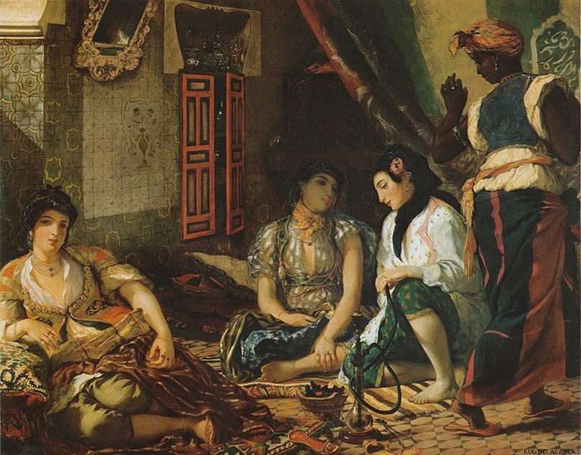
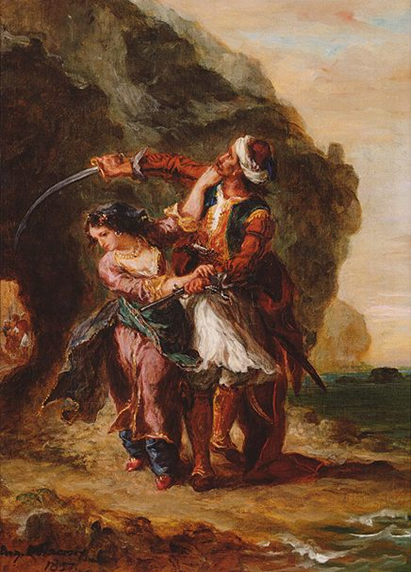
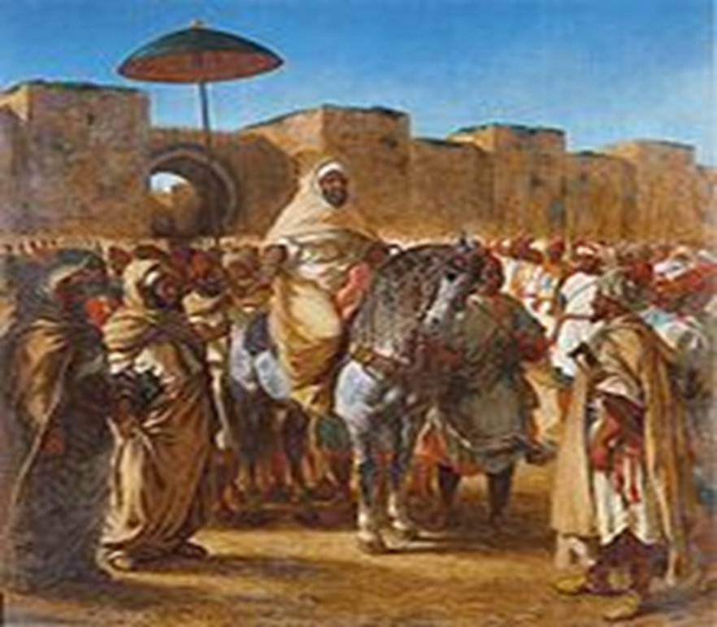
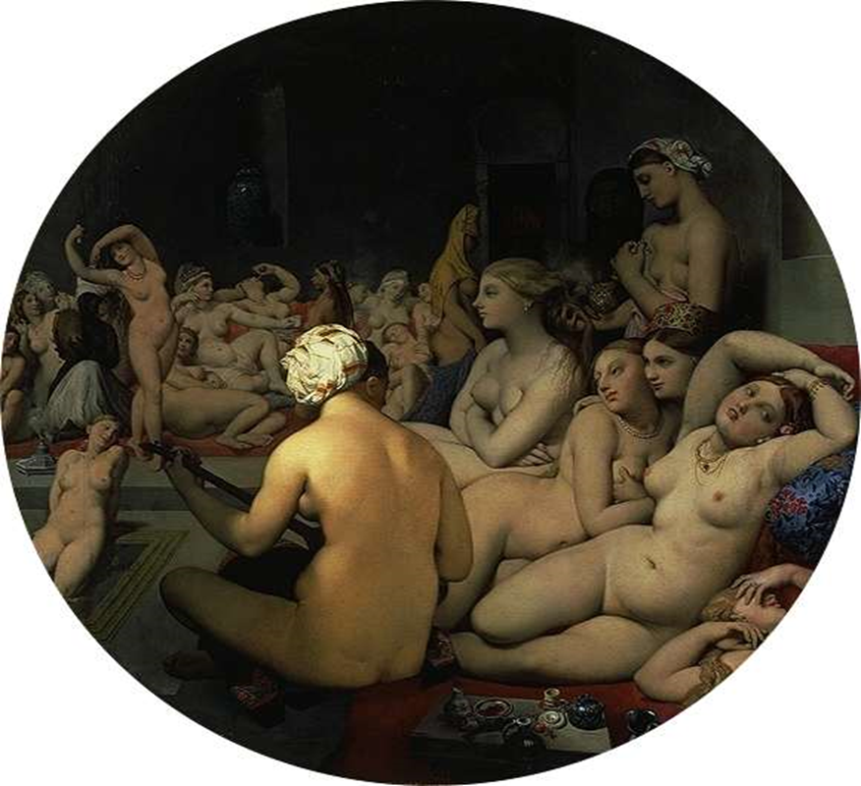
orientalism
Notes:
Western musical appropriations of the “East” can be conceptualized through Edward Said’s “orientalism” (1978), which examines the ways in which Europe during the period of the late nineteenth/early twentieth century has understood cultures beyond the “oriental line”. Music, photography, and other forms of representation were central in the production of orientalism.
The depiction of female sexuality is noteworthy in orientalism. Representations of women were created and perpetuated by men (Lewis 2004), and these operated within the binary imagination of civilisation vs. nature, white vs. other, and male vs. female, while establishing the oriental (Harem) women as exotic, different, and other. The orient becomes an imagined place of pleasure, travel, and escapism for european males, “a kind of mysterious place full of secrets and monsters… ‘the marvels of the East’” (Edward Said; in Jhally et. al. 2005:4).
Popular music expressions during the twentieth century similarly absorbed exotic symbolisms and sought to evoke the faraway, while becoming thoroughly objectified and commodified for western consumption.
Optional audio-visual study: Edward Said: On Orientalism

Slide 40
Notes:
An interesting example is presented in Sting’s “Desert Rose” (1999). The video to the song depicts Sting as a lone traveller in the desert, equipped with a handheld camcorder and chauffeured in a black luxurous Jaguar by a female driver. Textually and visually, this song evokes a world of fairy tales, the world of 1001 nights, evoking fictional, historically past worlds. Sting sings of dreaming of an oasis and love. It contains sexual promise through the signifier of an imaginary, mysterious woman from the desert (desert rose). The landscape places the woman outside time in a natural environment (desert), and outside or beyond the modern, civilized world, stretching back timelessly. It offers escape from the modern world, while positioning the imaginary woman as an exotic treasure (as a desert flower, and sweet desert rose), an object that can be possessed by the white man (Sting). It also stereotypes Middle Eastern women as sexy and different.
Audio-visual study: Sting ‘Desert Rose’ [embedded YouTube video]. Available at http://www.youtube.com/watch?v=-bxRewGi77k

Slide 41
The DVD cover and text is selling to the audience a heightened sense of ‘exoticism’, ‘orientalism’, and thus ‘essentialism’. Stereotypical clichés are used to highlight the difference to Western culture: magic and mystery (versus rationalism and reason); hypnotic rhythms (versus structure); epic (as opposed to ‘real’); ancient (versus modern); desert (versus futile); dazzling and cinematic (emphasising the Western ‘gaze’ at the ‘other).
The text on the DVD reads:
A one-hour soundscape that brings to life all the magic and mystery of the East through hypnotic rhythms and gorgeous epic settings. Filmed at ancient sites in places such as Morocco and Egypt, this desert fantasy takes the viewer on a dazzling musical journey of cinematic proportions.
On the website, the opening reads as follows www.wliw.org/productions/harem.html:
A musical fantasy becomes a visual feast -- teeming with epic and timeless settings, shimmering colors, and sensuous images -- in the new TV special inspired by Sarah Brightman's new worldwide hit recording Harem on Angel/EMI Records. Filmed on location throughout ancient Morocco, HAREM: THE SARAH BRIGHTMAN SPECIAL - A DESERT FANTASY lends a new dimension to the experience of the recording, on which Brightman's soaring soprano reaches into a new creative dimension, inspired by the sounds and images of the Middle East of legend.
Notes:
Another example of orientalist representations is Sarah Brightman’s Harem, A Desert Fantasy (2003 [DVD]). The DVD is a mixture of performance footages and other recordings, notably pop-like songs with a strong underlying dance beat, which has been described as “a one-hour soundscape that brings to life all the magic and mystery of the East through hypnotic rhythms and gorgeous epic settings. Filmed at ancient sites in places such as Morocco and Egypt, this desert fantasy takes the viewer on a dazzling musical journey of cinematic proportions”, as in the liner notes of the DVD. The DVD cover and text is selling to the audience a heightened sense of exoticism through stereotypical clichés that reconstruct the difference of the Middle East, using terms like magic and mystery, hypnotic rhythms, epic, ancient, desert, dazzling, and cinematic, which stand in stark contrast to western values and beliefs in rationalism and reason, rhythmic structure, objective and scientific, modern, developed, (emphasising the Western “gaze” at the “other”). The website similarly constructs orientalist representations of the Middle East.
Image credit: DVD cover of Harem: A Desert Fantasy, available at http://www.imdb.com/title/tt0429059/

Slide 42
conclusions
Subtle forms of racism/orientalism continues to play a significant role in commercialized popular culture in neoliberalism. Myths surrounding orientalist representations in popular culture that result from capitalist intentions in order to create a panoptic view of exoticness and otherness are easily spread in today’s culture and accepted as “true” reality, in turn becoming constructed hyperreality in the form of distorted knowledge and its consumption. This process provides the conduit for the permeation of western knowledge and eurocentric perceptions of the norms, values, and beliefs of non-western, non-European cultures, which does not lead to a cosmopolitan utopia, but has, to many critics, achieved the antithesis of it.

