Slide 1
Session 8
Cool Masculinities

Slide 2
synopsis
This session continues to conceptualize cool capitalism and illustrates the way that coolness is gendered, since it is theoretically ascribed to masculinity rather than femininity. It is determined by “male” individualism that requires distance from the feminine and particularly from maternal notions. The concept of cool is thereby often (but not exclusively) regarded to be a male phenomenon. Today coolness is often intrinsically linked to black popular culture, providing a powerful explanation for the current popularity of hip hop and its huge branding potential. Even so, coolness is not unique to Hip Hop alone. It is global and colourless today. Coolness has also been hugely relevant in the success of earlier “hyper-masculine” and queer musical styles, including rock and heavy metal, as well as World Music.

Slide 3
Patriarchy and Resilience in Neoliberalism
gender and race has been updated in neoliberalism… Robin James’ “multi-racial white supremacist patriarchy”
the neoliberal myth of postracialism and postfeminism
where sexism and racism are still visible, this sexism and racism looks “black”
e.g. contemporary commercialized Hip Hop
Early 21st century globalized western race/gender/sexuality/capitalist hegemony is thereby marked by the techniques of resilience and (black) exclusion from the white mainstream.
Notes:
As we have discussed in the previous session 7, neoliberal ideology conceives of everything in economic terms. This has in turn changed how gender and race work. A useful concept to understand gender and race in neoliberalism is Robin James’ of “multi-racial white supremacist patriarchy” (this has replaced bell hooks’ white supremacist capitalist patriarchy).
In neoliberalism, the old binary divisions have gradually been replaced by the “acceptance” of all sorts of differences, at least at the surface. Femininity, blackness, queerness, disability, class, etc. have been updated in neoliberalism’s preferred mode of deregulation. Robin James describes this as the neoliberal myth of postracialism and postfeminism.
Yet there are still instances where sexism and racism are visible. In such instances, this sexism and racism looks “black”, which is clearly evident in much contemporary commercialized Hip Hop, in which young black men are made responsible for the “backwards” and inefficient or unhealthy phenomena of sexism and racism.
Early 21st century globalized western race/gender/sexuality/capitalist hegemony is thereby marked by the techniques of resilience and (black) exclusion from the white mainstream.

Slide 4
Coolness….. to understand the way that contemporary music styles have been “upgraded” to integrate them more fully into contemporary neoliberalism
Cool neoliberal pop-rock music is “resiliently noisy”…. resilience and disaffection is integral to “cool”
Hip Hop:
In the twenty-first century, hip hop’s sonic and racial noise is no longer a disruptive force, but a profitable feature in cool capitalism.
Neoliberalism co-opts negation and opposition and redistributes this force critical force into the service of privileged groups”
Resilience discourse in contemporary popular culture
Notes:
Neoliberal upgrades to capitalism and to ideology have impacted on contemporary world popular music, and (as we have seen in session 7) coolness provides a useful lens through which to understand the way that contemporary pop-rock styles have been “upgraded” to integrate them more fully into contemporary neoliberalism.
Cool neoliberal pop-rock music is resiliently noisy, which contemporary western pop audiences hear as music (James 2015:43).
Hip hop illustrates one way that pop music has been upgraded so that its logic and aesthetics are compatible with neoliberal norms and ideals. While early hip hop was literally noisy, twenty-first century hip hop’s sonic and racial noise is no longer a disruptive force, but a profitable feature within cool capitalism, even though it continues to be associated with racial blackness.
Yet its noisiness is no longer perceived as a disruption of mainstream tastes or hegemony, and is often directly appropriated by big business, for example in advertisements for all sorts of products.
Neoliberalism thereby co-opts negation and opposition (e.g. queer negation, critical black aesthetics) and redistributes “their negative, critical force [while] putting it in the service of privileged groups” (James 2015:56). The conquest of cool in contemporary pop-rock music represents the mainstream co-optation or gentrification of racial, gendered, etc. negativity.
Resilience discourse is vividly present in contemporary world popular music, which is “performed as a spectacle for others [to] be seen and heard” (James 2015:88). Resilience means to recycle suffering and pain inflicted by “damage” (racism, suppression, exclusion) into learning, and visualize struggle and/or triumphant overcoming of this damage.
The example that follows reveals the racialized and gendered economy of neoliberal capitalism and its resilience narratives, which are explored here under the umbrellas of cool masculinities (this session) and cool postfeminism (session 9).

Slide 5
CONTEXTUALIZING HIP HOP COOLNESS
The spectacular incorporation of rap represents the astonishing capacity of cool capitalism to repackage virtually anything for mass distribution. So even the most brutal, misogynistic and homophobic features of some strands of rap and hip-hop culture became another consumer item, to be tasted and discarded at will. (McGuigan 2009:98)
Notes:
Coolness is gendered, since it is theoretically ascribed to masculinity rather than femininity. It is determined by “male” individualism that requires distance from the feminine and particularly from maternal notions (Fraiman 2003:11). The concept of cool is thereby often regarded to be a male phenomenon, and today it is often intrinsically linked to black popular culture (Nancarrow, Nancarrow and Page 2001:313; Holmes and Negra 2011:191). Coolness provides a powerful explanation for the current popularity of hip hop and its huge branding potential.
Hip hop is arguably the epitome of cool in 2016. Regarded by some as the new rock ‘n’ roll, rappers continue to establish themselves as cultural icons and powerful brands (Balaji 2012:314). Hip Hop’s success has grown out of a combination of cool capitalism and a rebellious attitude, perhaps most directly exemplified by the phenomenon of “bling” (McGuigan 2009:95-96). Hip Hop is a prime example of “black cool” in its embrace of capitalism and, with it, the neutralization of rebellion and disaffection in black culture.

Slide 6
Authenticity & branding
Notes:
The genre’s transition from a subculture to mainstream popular culture over the last thirty years has meant a constant strive to sustain a “pure” identity based on authenticity and (street) credibility, or “keeping it real”. Being authentic and credible is essential to being considered cool and ultimately determines an artist’s success. Authenticity and street credibility in Hip Hop is achieved by using “bottom-up” branding processes and establishing layers of creative intermediaries between the artist and corporate decision makers.
Intermediaries, such as the record label Cash Money, founded by Birdman, an established rapper and producer, guide the creative process to ensure it meets the corporation’s requirements, while recognizing regional trends, legitimizing the artist’s street credibility, and ensuring authenticity. Intermediate hip hop labels themselves must therefore be deemed street credible and authentic in order for the rapper to be considered cool (Baroucka 2013:206).
Cash Money represents such “big” names as Drake and Lil Wayne, who often reference the label in their songs, and yet they are usually owned by one of the Big Three who construct powerful brand extensions around a rapper’s image.
Brand extension into different products and services beyond hip hop is crucial to the economic success and longevity of an artist (Lieb 2007:202). Brand extension is defined as the use of an established brand name in order to enter new product classes or categories, and the hip hop genre has the largest breeding ground for such endeavours (Borucka 2013:15). The emergence of 360 deals reflects this trend. For example, Lil Wayne, in collaboration with his imprint company Young Money Entertainment, which is owned by Universal, created a successful line of what many youths regard to be cool merchandise. Other successful brands in Hip Hop include Sean Combs (Diddy), Dana Owens (Queen Latifah), 50 Cent, and even Beyoncé with her House of Dereon fashion line.
Further optional study/image credit: Screenshot of Cash Money [record label], available at http://www.cashmoney-records.com/, accessed 24 March 2018.

Slide 7
Hip Hop Entrepreneurship as resilience
“Hip Hop artists not only brag about their entrepreneurial skills in their songs, they are CEOs of multiplatform brand enterprises” (James 2015:116)
Notes:
It is commonplace for rappers to mention their own brands in a song: for example, Beyoncé’s husband, Jay-Z, mentioned his clothing line Rocawear extensively in the song “All I Need”, which supports brand recognition and coveys the notion that the brand is cool (Oliver and Leffel 2016:44).
In their embrace of entrepreneurship as both a practice and a masculine ideal in the first decades of the 21st century, “Hip Hop artists not only brag about their entrepreneurial skills in their songs, they are CEOs of multiplatform brand enterprises” (James 2015:116), and Jay-Z often raps about his boardroom strategy, while still retaining his authenticity and street credibility.
Hip Hop entrepreneurship has become a means for black masculine resilience, that is, a way for black men to overcome stereotypically black masculine pathology and to move closer/into the respectable “multi-racial white supremacist patriarchy” society (James 2015:116).
Optional further study/image credit: Screenshot of Jay-Z’ Rocawear website, available at https://www.rocawear.com/, accessed 24 March 2018.

Slide 8
Hip Hop coolness is evoked in the language used by rappers, and music corporations encourage artists to rap what is deemed cool in wider hip hop culture—drugs, crime, sex, violence—to enhance a rapper’s black masculine brand personae.
References to locales…. the ghetto
Being perceived as non-mainstream and untainted by commercialism is key to a rapper’s perceived cool status.
Notes:
Hip Hop entrepreneurship is often framed as gendered resilience narrative, exemplified in the “war-on-drugs racialized, gendered, and class-inflected damage [as] the very basis of entrepreneurial rap success game” (James 2015:116). Coolness is thus evoked in the language used by rappers, and music corporations encourage artists to rap what is deemed cool in wider hip hop culture—drugs, crime, sex, and violence—to enhance a rapper’s black masculine brand personae, which stands in stark contrast to political or underground hip hop with its focus on inequality, racism, and urban storytelling.
Authenticity and street credibility is often constructed by rapping about where artists are from—their locales. By referencing specific locales, rappers often associate their identity with the ghetto, despite the fact that the vast majority of their audience is not from or accustomed to such communities. For example, Drake often raps about his humble beginnings, but has been heavily criticized when it emerged that he was brought up in a fairly upper-class suburb in Toronto (Roberts 2013).
Being perceived as non-mainstream and untainted by commercialism is key to a rapper’s perceived status, particularly within the early stages of his career and when the brand is being established. Record labels use street teams and guerrilla marketing strategies in order to create a grassroots following and keep brands on trend, which contributes to an overall edgy and cool image (Balaji 2012:315).

Slide 9
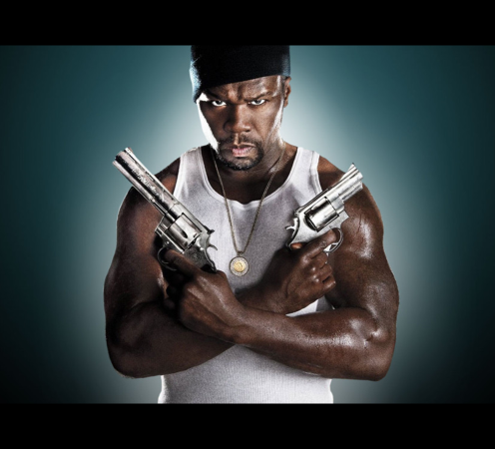
A specific brand of black Masculinity
racialized/black hyper-masculinity
exploitative representations of women
Patriarchy, sexism, misogyny
violence
homophobia
Notes:
Another key to Hip Hop’s success is the use of stereotypes of specific brand of black masculinity. In order to be deemed cool and credible, men within hip hop must perform black hyper-masculinity, internalize exploitative representations of women, and promote patriarchy and sexism.
Since the 1990s, Hip hop has since become more insular, sexist, misogynistic, and violent. Black men in hip hop need to be perceived as “untamed, uncivilised and unfeeling” (hooks 2004:171). They need to express hardness through references to violence, drugs, and sex.
Sex plays a frequent role to enhance black men’s coolness and appeal to audiences (Belle 2014), whereby depictions of women in hip hop are limited to being accessories and sexual servants in positions of objectification (Ralph 2006:71; Aubrey and Frisby 2011:478). Women’s provocative clothing and submissive dance styles serve to enhance the coolness of the male rapper. This racialized hyper-masculinity is further enacted through the marginalization of gay men (homophobia) (Reynold 1997).
Optional audio-visual study/image credit: 50 Cent. A Brief History Lesson in Hip Hop: The Commercialisation of Hyper-masculinity. 2018. Available at http://hiphophub.co.uk/portfolio/the-commercialisation-of-hyper-masculinity/, accessed 27 March 2018.
Optionalal audio-visual study: Documentary Hip Hop: Beyond Beats and Rhymes (2006)

Slide 10
In gangsta rap, particularly, there is a connection between gangster lifestyle, gun violence and crime, drug use, misogyny, and powerlessness (economic, political, and so forth) in a white-dominated capitalist society.
Gangsta rap forms of hip hop have become the “typical soundtrack” of a racially and male-defined urban landscape, which is shared but rarely shaped by young black women.
Notes:
Misogynistic aspects are particularly evident in gangsta rap, where black women’s bodies “have been reduced to isolated body parts and defined solely by their sexuality” (Yousman et.al. 2007:12). Women’s rights, concerns, and desires are poorly, rarely, or never represented in these musical constructions. Instead, women of colour are blatantly mistreated as objects and props that are barely clothed, continually gyrating, and readily available for the sexual pleasure of cool black men.
In gangsta rap, particularly, there is a connection between gangster lifestyle, gun violence and crime, drug use, misogyny, and powerlessness (economic, political, and so forth) in a white-dominated capitalist society. gangsta rap forms of hip hop have become the “typical soundtrack” of a racially and male-defined urban landscape, which is shared but rarely shaped by young black women.
There is a clear need for a fuller understanding of why such lifestyles are constructed and popularized by the media corporations, including the appeal of status afforded to gangster lifestyle (e.g. the God Father figure) or the commercial promise associated with exaggerated representations of urban icons like drug dealers and pimps.

Slide 11
Cool masculinity and “playing it cool”
Hip hop represents the continuation of a stereotyped fantasy
The excessive misogyny in Hip Hop results from executives’ “racist ploys to scapegoat black men, making them seem responsible for the misogyny that is actually a central feature of white supremacy, too” (James 2015:114).
Black rappers are constructed and represented in Hip Hop as non-resilient, working-class, non-bourgeois, urban-black individuals that are usually embodied in thug stereotypes.
Visualization in neoliberal culture racializes particularly “non-resilient” women as black.
Notes:
Cool masculinity in gangsta rap has certain resonances with the jazz slang “playing it cool”, which was used by jazz musicians to describe an emotional mode and style of aesthetic detachment evident in cool jazz of the 1920s. Playing it cool was the direct opposite to “being a fool” (Dinerstein 2017:24). The cool man resembled a new style of American manhood through the coarse and vulgar working-class and gangster figure. American popular entertainment thereby shaped ideas surrounding American manhood as an expression of male violence, misogyny, and homophobia (Jhally et al. 1999).
In constructing the cool masculine façade, hip hop represents the continuation of a stereotyped fantasy that has its roots and causes in “imperialist white supremacist capitalist patriarchy” (bell hooks 2004:17) and continues in neoliberal “multi-racial white supremacist patriarchy” (James 2015). As bell hooks has argued, the excessive misogyny in Hip Hop results from executives’ “racist ploys to scapegoat black men, making them seem responsible for the misogyny that is actually a central feature of white supremacy, too” (James 2015:114). Black rappers have been the scapegoats of white supremacist patriarchy, who are constructed and represented in Hip Hop as non-resilient, working-class, non-bourgeois, urban-black individuals that are usually embodied in thug stereotypes.
Moreover, visualization in neoliberal culture racializes particularly “non-resilient” women as black, which separates out “toxic” black women from everyone else (James 2015:103).

Slide 12
Continued oppression/exploitation of non-bourgeois black men and non-resilient black women in Hip Hop….
Consequently, coolness as a survival strategy in imperialist white supremacist capitalist patriarchy has cost the black male an enormous price:
While it represents black identity and pride in the ghetto, such “compulsive masculinity” in that context is also seriously damaging to both women and men, not to mention the druggy lifestyle, disorganized sociality and violent criminality associated with it – which is by no means confined to working-class black males in the USA. (McGuigan 2016:36)
Notes:
This portrayal of hyper-masculine identities of black men and misogynistic images of black non-resilient women at the expense of perpetuating stereotypical representations of black masculinity is used by record company executives purely for financial gain (Belle 2014:7). And the continued oppression/exploitation of non-bourgeois black men and non-resilient black women evidences that multi-racial white supremacy is not really post-identity (e.g. multi-racial, multi-gender, etc.) after all.
Although hip hop strives for perceived authenticity and credibility, demonstrated in its bottom-up branding approach, it is ultimately controlled by record company executives who dictate the limited narratives it supports. Across hip hop, black men are thus “repeatedly portrayed as violent, drunken, misogynistic savages [which represents] some of the most racist images in media history, harkening back to D.W.Griffith’s controversial 1915 film Birth of a Nation, which justified white supremacy by representing black men as animalistic, boorish abusers of white women” (Yousman et.al. 2007:12).

Slide 13
Other cool masculinities

Slide 14
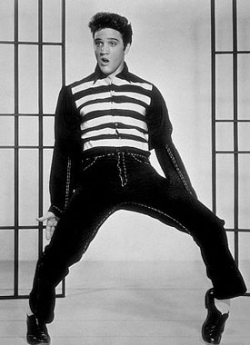
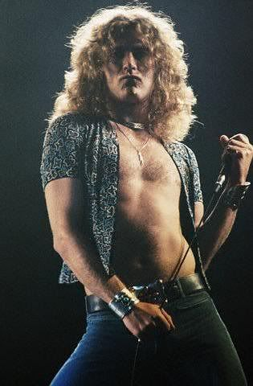
Notes:
Coolness today is not only about black American culture and is not unique to Hip Hop alone. Coolness has also been hugely relevant in the success of earlier musical styles, including rock and heavy metal. Indeed, there exist many similarities in the performance of a specific hyper-masculinity across these music genres.
The “conquest of cool” in rock music coincides with the cool sensibility of 1950s American mainstream, marked by “the rise of rebels without a cause”, who objected to middle-class life and business (McGuigan 2016:26). The countercultural movement of the 1960s, one of the most powerful social movements in American history, was “anti-consumption in orientation, hoping to chart a path toward greater social freedoms and equality. And it was accompanied by a soundtrack… rock and roll [that] produced bountiful profits for the record industry” (Taylor 2016:41). Thus the counterculture and, with it, the cool pose and “creativity” caught on quickly in corporate America and elsewhere.
In the music industry, male bodies have become objectified and eroticized, particularly male rock stars, who have been turned into cool objects of voyeurism and desire. Rock musicians often embody a rebellious, anti-establishment, even left-liberal or radical political ideology (Walser 1993:109), alongside a carefully constructed sex symbol image, with obvious examples including Elvis Presley, Robert Plant, Jon Bon Jovi, and Michael Hutchence.
The November 1967 article in Vogue Magazine, “Love, Mysticism, and The Hippies”, for instance, included a photograph of Jim Morrison, which firmly established Morrison as a cool sex symbol to women [see photograph to the right, which shows Morrison with model Donna Mitchell].
Image credits:
Out & About: Elvis is in the House. 2017. Available at http://www.norwoodnews.org/id=22541&story=out-about-elvis-is-in-the-house/, accessed 27 March 2018.
Robert Plant (by Henry Diltz). 2018. Available at https://www.1stdibs.com/art/photography/color-photography/henry-diltz-robert-plant/id-a_839153/, accessed 27 March 2018.
Love, Mysticism and the Hippies . 2017. Available at https://www.kurtvonmeier.com/kurts-words-1/2017/8/13/ssacewxuw9ptyqhl7frf3s85a8xuut, accessed 27 March 208.

Slide 15
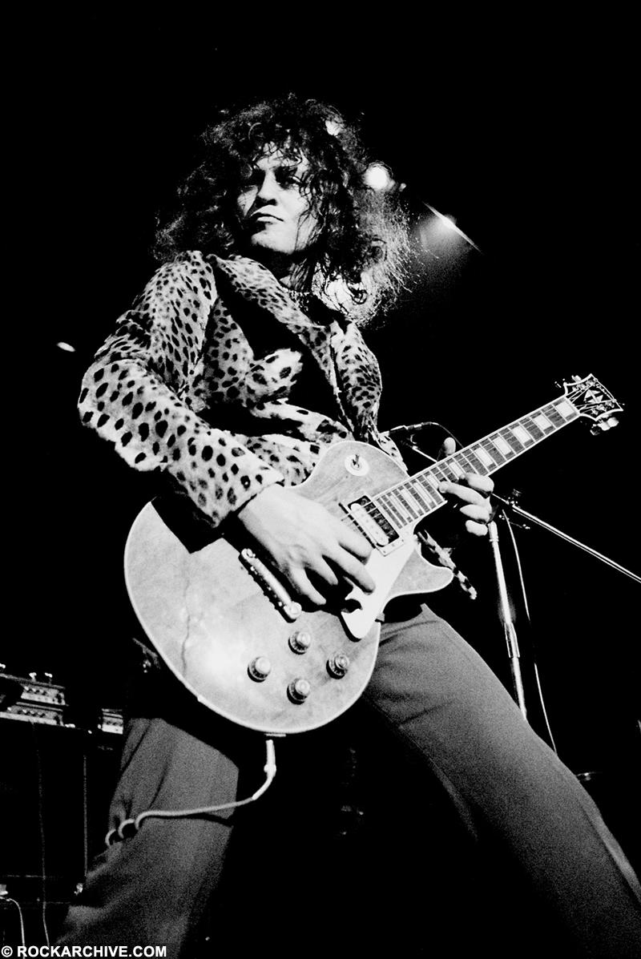
Notes:
The 1980s marked a shift in representations of masculinity in British mainstream pop toward “a more sensitive, less macho type” (Hawkins 2006:280). Continuing this trend well into the 1990s, representations of masculinity often blended “the soft and hard: a chiseled masculinity framed by beautiful clothes, makeup, and flawless complexion” (ibid.).
Thus besides more traditional modes of hyper-masculinity, this period also saw men who liked shopping and paid attention to their own appearance, accompanied by the emergence of the homosocial gaze.
This was evident in the emergence of “queer” personalities, including Marc Almond, David Bowie, Boy George, Jarvis Cocker, Elton John, George Michael, Morrissey, Jimmy Summerville, and “queer” bands, including Bronski Beat, the Communards, Culture Club, Depeche Mode, Frankie Goes to Hollywood, the Pet Shop Boys, Soft Cell to enter the British pop music scene.
The musicians and groups played on their queerness through camp mannerisms so as to represent a more ambiguous masculinity and challenge gendered stereotypes. As pop artists, they symbolized the disruption of gender and sex norms, and, through gender-bending spectacles, played out an emphasis on being “different” and, ultimately, cool.
Androgynous spectacle was one means to express the new sentiments surrounding masculinity during this time, particularly in “glam metal” and in the loud fashion statements of musicians like David Bowie, Marc Bolan (T Rex), Jeffree Star, Boy George, Marilyn Manson, and others, which challenged and transformed hegemonic masculine ideology.
Presenting masculinity as an androgynous spectacle is a fairly recent phenomenon, which results in a kind of glamour being attached to cool male objects of desire.
Image credits:
15 priceless quotes from David Bowie over the years that define his stardom. 2016. Available at http://www.businessinsider.sg/david-bowie-quotes-2016-1/, accessed 27 March 2018.
Marc Bolan (photographer Jorgen Angel). 1973. Available at https://www.rockarchive.com/artists/m/marc-bolan, accessed 27 March 2018.

Slide 16
Notes:
The use of androgyny in heavy metal challenged masculine “harder” styles of heavy metal by blurring hegemonic gender boundaries and questioning the “natural” exclusiveness of heterosexual male power. It is often seen to subvert male heterosexual privilege; indeed, with an implicit alignment to homosexuality and crossing of gender boundaries, androgynous displays threaten patriarchal control and power, and this resistance came to be regarded as cool.
Aerosmith’s “Dude Looks like a Lady” (1987), for instance, confronts gender stereotypes and anxieties evoked by androgyny, confronting the “problem” of gender bending with the tone of mock hysteria: the singer Steven Tylor (David Lee Roth) represents a feminized image on stage through his facial expression, dance moves, and dress style, counterbalanced by his actual involvement in bodybuilding and martial arts, which reaffirm conventional patriarchy.
Optional audio-visual study [embedded YouTube link]: Aerosmith ‘Dude Looks Like A Lady’ (1987), available at https://youtu.be/nf0oXY4nDxE, accessed 27 March 2018.
Thus by incorporating gender-ambivalent and queer representations, artists have succeeded in constructing coolness around themselves. Signifying an artist as queer (rather than being queer) in mainstream pop has been shown to achieve high record sales, popularity, and control. Appearance (rather than self-representation) is the determinant factor in their cool appeal through the spectacularization of gender play that mocks masculine conventions. Queering—the disavowal of the explicit homoerotic—parodies male domination and is essentially threatening and provocative, key ingredients of cool.

Slide 17
http://npg.si.edu/exhibit/Cool/images/madonna_full.jpg
Notes:
Queerness becomes a commodified signifier of the hip and the cool, and appeals to an audience that likes to think of themselves as edgy and different.
Madonna is an artist who has entered the status of a “cool legacy”, who has transformed the postfeminist landscape of American culture by combining dance-driven spectacle, erotic exhibitionism, and artistic omnivorousness. She is undoubtedly the most important female musical artist in recording history, with an immeasurable influence on such cool postfeminist music divas as Lady Gaga and Pink (Smithsonian 2014a).
It is precisely for this reason that Madonna’s photograph from 1983 was included in the “American Cool” exhibition at the Smithsonian National Portrait Gallery in 2014.
Image credit: Madonna. 2014. Available at http://npg.si.edu/exhibit/Cool/images/madonna_full.jpg, accessed 27 March 2018 (for educational use only).

Slide 18
Notes:
It was during the late 1980s that one of popular music’s biggest stars was catapulted into superstardom while reflecting the changing attitudes in society toward sexuality, identity, and patriarchy. No other artist captured more clearly the idealism of cool than Prince.
Born in Minneapolis in 1958 and signing with Warner at the age of 19, Prince represented a huge change of attitude toward ethnicity and sexuality in popular music. Prince is widely recognized as taking ideas surrounding gender and sexuality into previously unexplored arenas. His masculine persona stands in stark contrast to his more feminized demeanor and singing style.
Prince—his image, music, and relationship with women—is clearly a representation of cool queering, while he highlights the fact that patriarchy is as much a struggle and pain to men as it is to women.
Image credits:
Legendary singer Prince dies at 57. 2016. available at https://www.aol.com/article/2016/04/21/legendary-singer-prince-dies-at-57/21348758/, accessed 27 March 2018

Slide 19
Notes:
World Music also signifies coolness. It can provide a certain edginess or coolness that results from unfamiliarity with new sounds, the anxiety of the other, or simply from exoticism.
A current example of World Music that evokes the ideology of the cool is the Malian Tuareg musicians known as Tinariwen, who have managed to gain popularity and success in the international mainstream pop music market.
Tinariwen sing in their native Tamasheq dialect (and occasional sections in English), and the message of Tuareg liberation has always been at the very core of Tinariwen’s mantra. Tinariwen’s appeal rests in their lyrical message, combined with musical signifiers they communicate, the images and stories they spin around themselves:
It was no longer enough to have the right sound. Music would also need to be accompanied by a strong story and some photogenic characters. And like a mirage, one band emerged from the sands of the Sahara with the perfect backstory. “The legend has it that they went into battle with AK47s and electric guitars strapped to their backs.” (Andy Kershaw) Tinariwen were the Touareg nomadic warriors that rose from the deserts wars of Mali, bringing with them a slow African blues groove. ‘Lots of bands know how to rock, very few know how to roll. And Tinariwen, by God, they know how to roll. There's a slightly menacing quality to them. A kind of gang quality that I have not really seen since the heyday of the Clash.’ (Andy Kershaw) (Cooper et. al. 2013: 1:05:25)
Optional audio-visual study: How To Be A World Music Star (2013)

Slide 20
Notes:
Tinariwen are largely a guitar-based group, and their music reflects a Western blues and rock influence, which they absorbed into their music and spread via home-made cassettes throughout the Sahara.
Tinariwen’s identity as a guitar-based band places them in a global guitar culture. The guitar is “a globally mobile instrument whose form, tonal textures and associated playing techniques are the product of its appropriation and use in a variety of locally specific musical contexts” (Bennett and Dawe 2001:1). Moreover, “the electric guitar is probably the most iconic instrument of pop-rock… [and so] adoptions of electric guitars by musicians in different parts of the world gained the symbolic meaning of joining the ranks of the pop-rock aesthetic” (Regev 2013:49), thereby joining the ranks of a line of guitarists like Jimi Hendrix, Jimmy Page, and Eric Clapton.
Image credit: Tinariwen official website. 2018. Available at http://tinariwen.com/, accessed 27 March 2018.
Optional audio-visual study: Tinariwen ‘Tenere Taqqim…’. Available at https://youtu.be/uMUuuW13Fp8, accessed 27 March 2018.

Slide 21
In World Music, this authenticity often manifests itself “in the form of a particular affect – rage. Does the musician display anger about her racialized/ethnicized subject position and what is thought to have happened to her people?” (Taylor 2004:86).
Notes:
Their music is more specifically known as Tichumaren, which is synonymous with the Tuareg rebel movement between the Malian government and Tuareg rebel forces during the 1990s, which Tinariwen have always closely identified with.
This historical/emotional context imbibed the group with an element of authenticity, a quality that is actively sought out in the World music industry where cultural issues and politics are often at the forefront of media attention.
In World Music, this authenticity often manifests itself “in the form of a particular affect – rage. Does the musician display anger about her racialized/ethnicized subject position and what is thought to have happened to her people?” (Taylor 2004:86).
In the case of Tinariwen, there is certainly an element of “rage”. For example, their 2011 song “Tenere Taqqam Tossim” from their album Tassili, a hypnotic, guitar-driven piece that ends with the lyric [translated] I cry out to God on high/To bring my people together/In unity, makes clear that Tinariwen’s message is about the fact that the Tuareg people still have no autonomy and that the problem remains largely unresolved (Amico 2014).

Slide 22
It was really like a Western movie… you know… the Seventh Samurai. It was like that because one by one the dudes turned up, you know. Then there was the day when this thin guy with sort of tangled hair turned up where we were staying, and he just came, you know, quiet to the point to be this completely introverted-looking guy, and he sat down in the tent where we were having tea and he got his guitar out. And it was, you know, a moment that still sort of sends shivers down my spine thinking of, because he started to play the guitar so gently, you know, touching the strings, and this absolutely memerizingly beautiful scales [sic] and then hit a gentle rhythm and then started to sing. And there must have been 10 or 15 Tuareg men and women sitting round in the tent and when he hit the chorus, everybody started singing. You know, everybody knew the song. It was clearly a kind of anthem written by this guy, and I could tell that we were sitting with an absolute master. (Justin Adams) (Cooper et.al. 2013: 1:10:00)
Notes:
Another trait of authenticity is the band’s priority of message over profit. For instance, in their early career Tinariwen would provide free recordings to those who gave them blank cassettes. The Tuareg people spread across the African continent spreading their message of Tuareg unity. “Musicians would perform at ishumar parties where those who had cassette recorders recorded the sessions, which were then copied by new listeners.” (ibid.:97) This ethos has a startling similarity to that of punk rock in the Western world, and it is easy to see how this genuine expression of anger, rebellion, and independence might chime with a punk rock-inspired Western audience.
Even so, it took around twenty years for Tinariwen to achieve success outside of their Tuareg society, made possible through recognition by a French group known as Lo-Jo who supported the Malian Festival au Désert (Amico 2014). Producer Justin Adams describes his first encounter of Tinariwen in the Saharan desert as follows:
It was really like a Western movie… you know… the Seventh Samurai. It was like that because one by one the dudes turned up, you know. Then there was the day when this thin guy with sort of tangled hair turned up where we were staying, and he just came, you know, quiet to the point to be this completely introverted-looking guy, and he sat down in the tent where we were having tea and he got his guitar out. And it was, you know, a moment that still sort of sends shivers down my spine thinking of, because he started to play the guitar so gently, you know, touching the strings, and this absolutely memerizingly beautiful scales [sic] and then hit a gentle rhythm and then started to sing. And there must have been 10 or 15 Tuareg men and women sitting round in the tent and when he hit the chorus, everybody started singing. You know, everybody knew the song. It was clearly a kind of anthem written by this guy, and I could tell that we were sitting with an absolute master. (Justin Adams) (Cooper et.al. 2013: 1:10:00)

Slide 23
They do this fantastic thing where the women sit in circles and are playing the tindé drum, and suddenly on the horizon you see camels coming at top speed toward you. These guys with all the veils and in amazing costumes, looking cool as hell. And they come as close as they can to the circles of women, like young guys on motorbikes [rrrrrhhh], showing off basically. Then they start to control the camel and they circle the group, and this is where they do this kind of thing where they control the camel, and the camel… dances to the music. (Justin Adams) (Cooper et. al. 2013: 1:13:10)
Notes:
To Western music producers, Tinariwen’s lead singer looked like Jimi Hendrix, which further authenticated the group’s rock image. Tinariwen were subsequently promoted at the Malian Festival au Désert. And it was at this annual gathering of Tuareg people, which only turned into a festival in the late 1990s (Amico 2014:87) that Tinariwen became subjected to the Western conquest of cool.
Tinariwen’s appeal of cool in the eyes of Western music industry professionals who attended the Malian festival led to slots at British world music festivals like WOMAD, the most prominent multicultural festival devoted to the celebration of new, alternative forms of music (Hutnyk 1998:402), and subsequently more mainstream pop festivals, such as Glastonbury and Coachella, as well as appearances in the US. As Tuareg rebel music started to reach new audiences in Europe and the US, it became known as desert blues.
Tinariwen’s rise then, like their rise in Tuareg society, could be said to have been achieved through their carefully constructed indie rock promotion during the band’s live performances at western mainstream festivals and events, while spreading the political message of the plight of the Tuareg people.
Indeed, indie rock has become a firm part of the neoliberal ideology of cool: “Indie-inflected music serves as a kind of Trojan horse. Consumers feel they are discovering something that they believe to be cool and gaining admittance to a more refined social clique” (Sisario 2010:10).
Tinariwen have successfully tapped into the appeal of cool by their ability to present an authentic past to a modern audience. Tinariwen demonstrate powerfully that musicians who have the “right” sound, who are accompanied by a strong story, and who come with some photogenic characters can become successful by tapping into the appeal of the cool. It is then easy to understand the attraction that pop music fans would hold for Tinariwen.

Slide 24
Conclusions
As an ideal type, coolness is often described as “resistance to authority through creation and innovation” (Botz-Bornstein 2010:n.p.)
Coolness is a defining feature of contemporary commodification practices in popular culture, including music. It is the logic of neoliberal, open-market capitalism, the most recent regime of globalization.
Coolness is inherently gendered.
The gender roles represented in the global music industry have become narrower than ever, constructed around what is deemed to be cool in order to appeal to the consumers of today’s cool popular culture.
Notes:
Coolness is an arbitrary and intangible concept that has shifted over time in popular culture. In one time, the Beatles would be the coolest thing, in another one Lady GaGa, Beyoncé, or Britney Spears.
As an ideal type, coolness is often described as “resistance to authority through creation and innovation” (Botz-Bornstein 2010:n.p.), but creativity and innovation have historically been associated with male and masculinity. For female artists to be cool, they often have to revert back to well-stablished gendered conventions that have shaped the global music industry throughout its history.
Coolness is thereby inherently gendered. Coolness for females is based around their visual appearances, while for males what they do and say conveys coolness. And how this is perceived by consumers is dependent on cultural and contextual factors.
Nonetheless, coolness is a defining feature of contemporary commodification practices in popular culture, including music. It is the logic of neoliberal, open-market capitalism, the most recent regime of globalization. Coolness has led to the redefinition of cultural capital in society, in which the cheapest commodities are seen as cool. It confers status through knowledge of the cool, which marks a historical shift in the control of cultural capital away from social elites and toward the new technocratic bourgeoisie. To them, all sorts of goods become desirable and consumed for their perceived coolness, which is enhanced through branding.
In popular music, this is achieved through person branding and establishing a brand personae around particular artists, which meant to shift away from music and toward an artist’s image. In an over-crowded music market, branding is necessary to stay relevant and profitable. Artists’ images and identity and visualization techniques are therefore carefully and self-consciously calculated, constructed, maintained, and, if necessary, adapted.
Consequently, the gender roles represented in the global music industry have become narrower than ever, constructed around what is deemed to be cool in order to appeal to the consumers of today’s cool popular culture.

Slide 25
Cool capitalism illustrates “our” cultural complicities with white supremacist patriarchy and the persistence of racism and sexism in cool popular culture globally. Cool (neoliberal) popular culture extols celebrity and success, and promotes and celebrates values of the public self and possessive individualism.

